Slide 1
Creating a Civil Society Strategy for a New Economy
NENA Strategic Directions Group
Webinar – 10 March 2020

Slide 2
The New Economy Network Australia (NENA) is a network of individuals and civil society organisations working to transform Australia’s economic system
so that achieving
ecological health and social & economic justice
are the foundational principles and primary objectives of the economic system.
www.neweconomy.org.au

Slide 3
Our vision for the future

Slide 4
5 Core Principles
Ecological Sustainability:
That economic activity not only respects and operates within ecological limits, bioregional health and planetary boundaries, but also supports the regeneration of natural systems and recognises and upholds the inherent rights of nature.
Social & Economic Justice:
That everyone can participate and benefit from economic activity in inclusive and equitable ways and that this requires working in solidarity to address the historical and ongoing marginalisation of certain groups by racism, imperialism, classism, patriarchy and other systems of oppression.
Democracy:
That economic decision-making is participatory, inclusive and transparent and emphasises collective stewardship and management of economic resources, activities and outcomes.
Place-based/ Emphasising Locality:
Creating greater resilience and strengthening community by rooting wealth and power in place through localised economic activity.
First Nations People in Australia
NENA acknowledges that the sovereignty of the First Nations People of the continent now known as Australia was never ceded by treaty nor in any other way. NENA acknowledges and respects First Nations Peoples’ laws and ecologically sustainable custodianship of Australia over tens of thousands of years through land and sea management practices that continue today.
NENA also acknowledges and respects the ancient, Earth-centred, steady state economic system that was created and managed by First Nations People across the continent for millennia. Australian society is in debt to First Nations People for many aspects of the modern economy

Slide 5
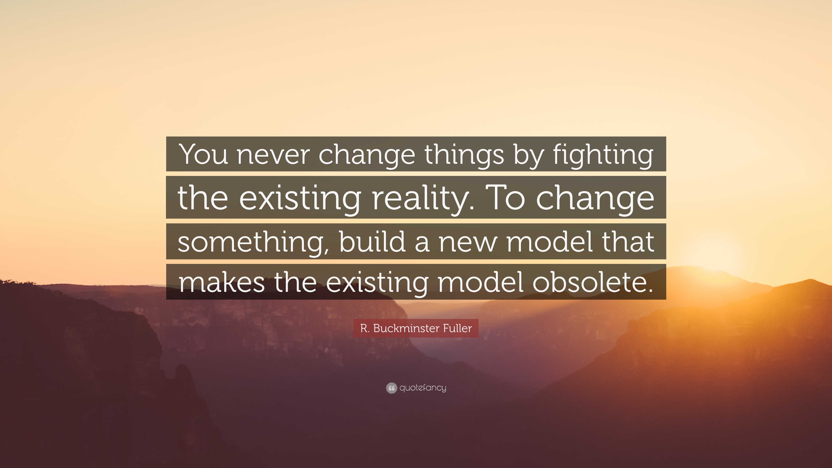

Slide 6
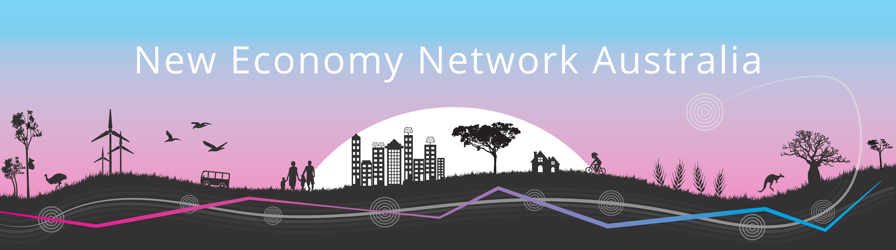
This presentation
1. Stories from the Newcastle Hub – a vision for change
2. Brief History of NENA
3. Original vision for “distributed governance” structure for network and strategy creation
4. 2020 Development of NENA Civil Society Strategy for New Economy (outward looking change strategy)
  Suggested Approach
  Suggested Timeline
5. Questions/discussion

Slide 7
1. History of NENA

Slide 8
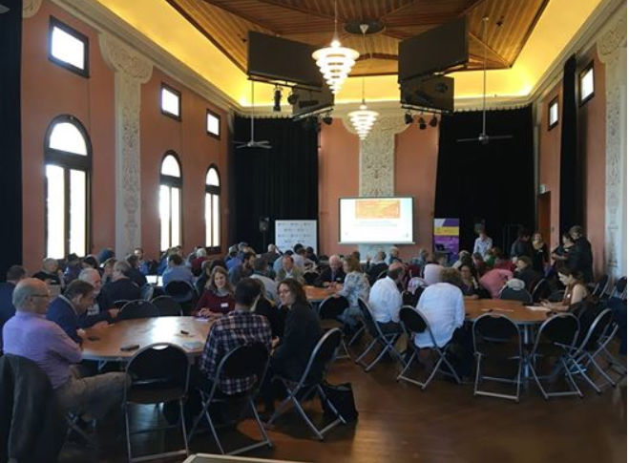
History of NENA
* 2014-2015 peer to peer discussions (Bronwen, Michelle)
* 2016 Conference – Sydney – agreement to create a network
12 working groups created after 2016 conference – many facilitated working groups then created the 2017 conference

Slide 9
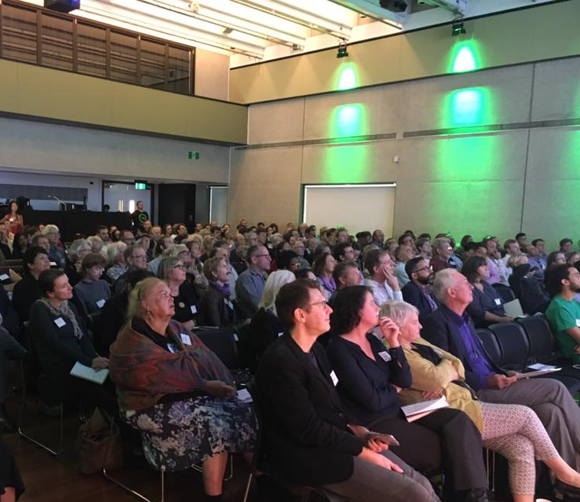
2017 Conference, Brisbane
– NENA launched
2018 Conference, Melbourne
- governance working groups
2019 – Feb incorporated as a cooperative, October - Perth conference

Slide 10
About NENA
NENA works to facilitate connections, showcase and promote innovative projects, build peer-to-peer learning and use collective strategies to advocate for change, so that we can build a strong movement of people demanding, creating and benefiting from a ‘new’ economy.
There are three dimensions to NENA’s work:
** We are building networks, connections and shared initiatives:
  Within specific geographic areas such as towns/cities, regions and states;
  Within and across different sectors within the new economy, including: sustainable food, energy, transport, housing, indigenous economics, ecological economics and many more; and
  that prioritise specific strategic goals every year

Slide 11
NENA Activities
Distributed governance – sectoral and geographic hubs around Australia
Members of NENA work together to:
  Build a ‘community of practice’; a network where people who want to build the New Economy can find each other, learn from one another, share information and participate in different kinds of movement building.
  Facilitate collaboration, education and peer-to-peer relationships that strengthen the Network and the movement.
  Facilitate, host and co-host events and projects that strengthen relationships between members and work to achieve the objects of the network.
  Create processes to enable Members of the Network to promote their work, connect with others, and invite support for their cause or advocacy campaign

Slide 12
Two sides to our “big picture” work
Outward focused strategy for creating change
Civil Society Strategy for a New Economy
Inward looking – ‘business plan’
NENA Operational Strategy

Slide 13
Activities since NENA Launch in Oct 2017
Developed Governance Structure
  October 2017 to July 2018 – Governance Working Group
  More than 25 meetings, 20 versions of developing documents, reconciling many different ideas
Annual Conference 2018 – Melbourne
Setting up and growing Hubs – during late 2018, all of 2019
Regional Symposia in 2018 – North Queensland & Perth
Regional Symposia in 2019 – East Gippsland, Newcastle, Margaret River (WA)
Incorporated – Feb 2019, Membership opened April 2019
Annual Conference 2019 – Perth
First Elections – 2019, Perth Conference
NENA Journal
Next Annual Conference – Newcastle, 20-22 November 2020
This year – 2020 – we need to keep moving forward
  Build on foundations to strengthen hubs
  Bring hubs into shared space, to develop our Civil Society Strategy for a New Economy

Slide 14
2. Original vision for distributed governance structure for NENA

Slide 15
NENA is built on Geographic & Sectoral Hubs.
The role of “hubs”:
Individual members (individual people and organisations) are the building blocks of the network
The‘Hubs’ were designed to enable different groups to have semi-autonomous ways of working together – without centralized control
It is a REQUIREMENT of NENA Membership that every member join a Hub (any Hub) and participate in a minimum of only 2 meetings per year (OR, alternatively, volunteer several hours per year to help with administration of NENA etc)
The plan is to ensure Hubs have information flowing into them and back out of them, to all other elements of the Network
The development of NENA Strategies will need:
  Processes for NENA Hubs to input as a group (to help refine priorities)
  Processes for individual members to input as individuals (eg online surveys, feedback and input at conferences)
  PLEASE SEE THE NENA HUB GUIDE – WORTH A READ, TO SEE HOW HUBS SHOULD BE CREATED AND WORK TOGETHER

Slide 16
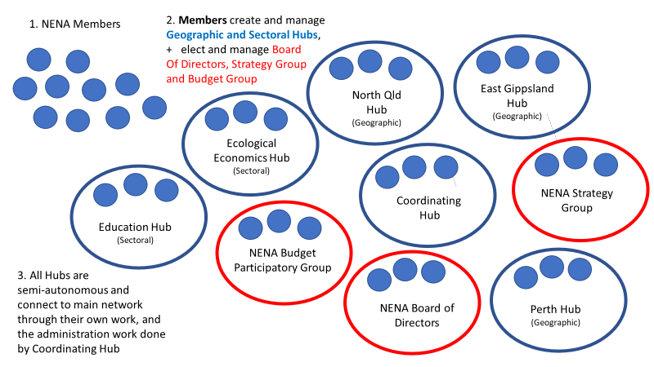
The overall structure of the Network: members + geographic and sectoral “Hubs”

Slide 17
Geographic Hubs so far -
Sydney
Melbourne
Brisbane
Adelaide
Perth
Darwin
North Queensland
East Gippsland
Newcastle and Hunter

Slide 18
Sectoral hubs created so far:
First Nations economics
rural and regional economies
cities and urban communities
food
health
cooperatives
democracy and governance
ecological economics
energy
education
faith groups
finance economics
housing
localisation
transitions
money and local currencies
Narratives and storytelling
personal dimensions and healthy cultures in the new economy
Universal Basic Income
Women in the New Economy

Slide 19
Why we created the Strategic Directions Group
When we created NENA, we didn’t want all the responsibility and “power” residing with just the Board of Directors – but we had to have a legally incorporated management group …
So after lengthy discussions, we created a structure whereby the hard work and expertise of EVERY member could help co-create the network’s activities, and guide future strategies
It is a REQUIREMENT of NENA Membership that every member join a Hub (any Hub) and participate in a minimum of only 2 meetings per year (OR, alternatively, volunteer several hours per year to help with administration of NENA etc)
The creation of the Hubs, was complimented with the Creation of two elected entities, that are to work alongside the Board of Directors:
  Strategic Directions Group
  Participatory Budget Group
The Strategic Directions Group has several responsibilities in the Constitution:
  Primarily – ‘regular strategic plans’ for the cooperative, and provide ‘general advice’ to the Board about strategic priorities
  In addition, we envisaged the SDG being made up of people from across NENA Hubs, and helping to guide the process for getting all Hubs to input to the Civil Society Strategy
  ** SDG MEMBERS ARE ELECTED FOR 2 YEARS **

Slide 20
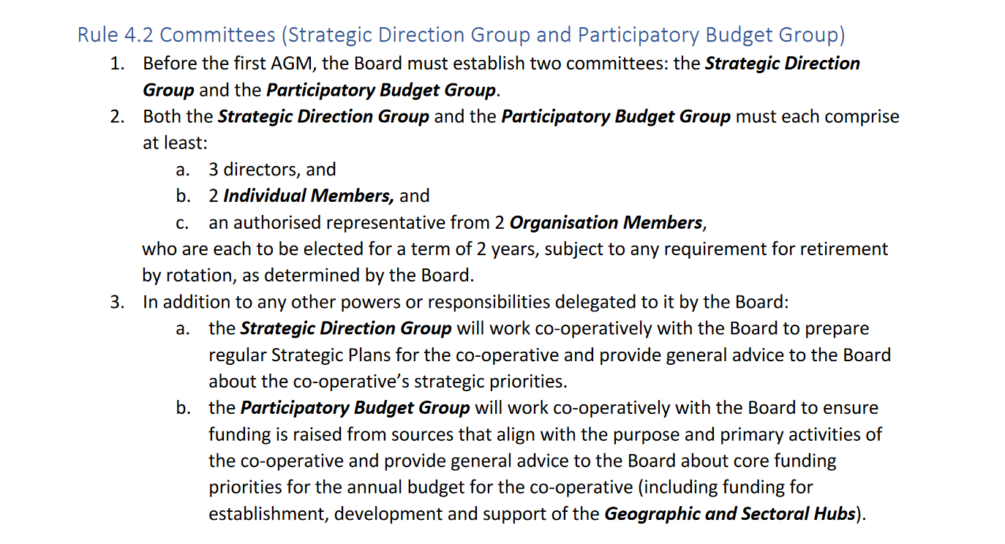
SDG in the NENA Constitution:

Slide 21
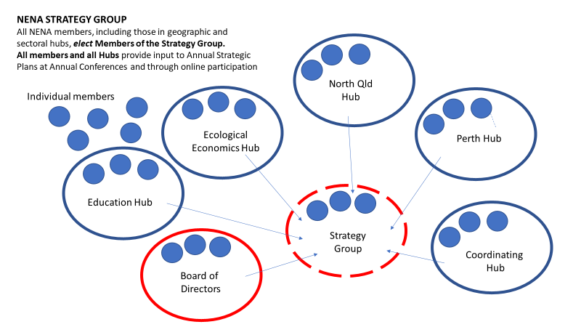
Role of the SDG – helping the whole network develop shared strategies

Slide 22
Two sides to our “big picture” work & both areas need the SDG’s guidance
Outward focused strategy for change
Civil Society Strategy for a New Economy
Inward looking – ‘business plan’
NENA Operational Strategy

Slide 23
4. 2020 Development of NENA Civil Society Strategy for New Economy (outward looking change strategy

Slide 24
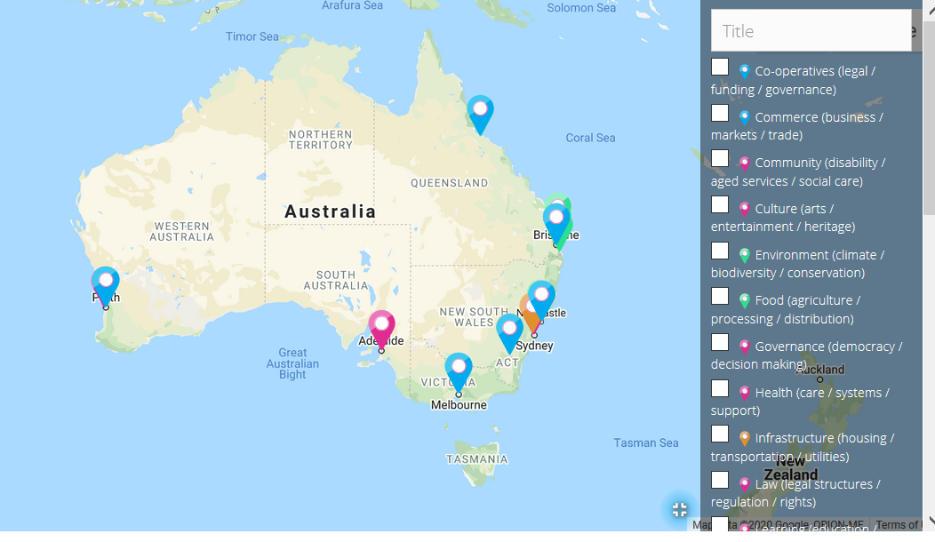
How hubs will work together
Food
Ecological
transport
Health
Energy
International
Faith
First Nations
SECTORAL HUBS
Identify sectoral
priorities
Across different scales,
(local, bioregional,
state, National) - including collaboration
with local hubs, around
local sectoral issues
GEOGRAPHICAL HUBS
– Identify local priorities
- Create and implement
local plans
- AND feed local priorities
into National Strategy
SDG assists
ALL these processes
Civil Society Strategy for a New Economy

Slide 25
Tools for enabling NENA Hubs and NENA Members to ‘input’ to Civil Society Strategy
Geographic Hubs can run their own processes, create their own semi-autonomous action plans for their LOCAL REGION – and ALSO identify priorities in their region for the Civil Society Strategy (and where possible, connect with sectoral hubs – but not essential)
Sectoral Hubs can discuss and develop their priorities in their own sector + find ways to cross-pollinate ideas with other sectors + CONNECT WITH GEOGRAPHIC around different sectoral issues
  How?
  Hubs will be encouraged (and helped) to discuss and fill out TEMPLATE for identifying priorities
  Individuals (ie all members) will be invited to read finished “input” to Civil Society Strategy and fill out surveys/questionnaires to support/challenge ideas

Slide 26
Template for hubs and members to use
https://www.neweconomy.org.au/about/governance/national-strategy/

Slide 27
Timeline for creating NENA’s very first Civil Society Strategy for a New Economy?
February – July
  monthly webinars JUST for NENA Hubs to hear about Strategy Development process and share info with each other (Michelle will lead facilitation but would be grateful to others to help too!)
  All members of the SDG assist several Hubs to activate their Strategy Development process – eg encourage/help/explain how to fill out templates; collate info and start an internal process to analyse input
  SDG meets at least monthly, to gather information, start collating similarities and differences and start mapping out core priorities for NENA, based on Hub ideas
June-October
  SDG works on a DOCUMENT for the Civil Society Strategy, drawing in NENA Hub input from Feb-July and filling in gaps by inviting people to contribute to hubs and provide additional info etc etc
  Draft Document out to all members in Sept or October
  Online polls to see where people agree, where contentious points are
November
  Sessions at the NENA Conference (20-22 November, Newcastle) to tease out, discuss, resolve/ or hold in contention, various points …

Slide 28

Discussion ☺

