Slide 1
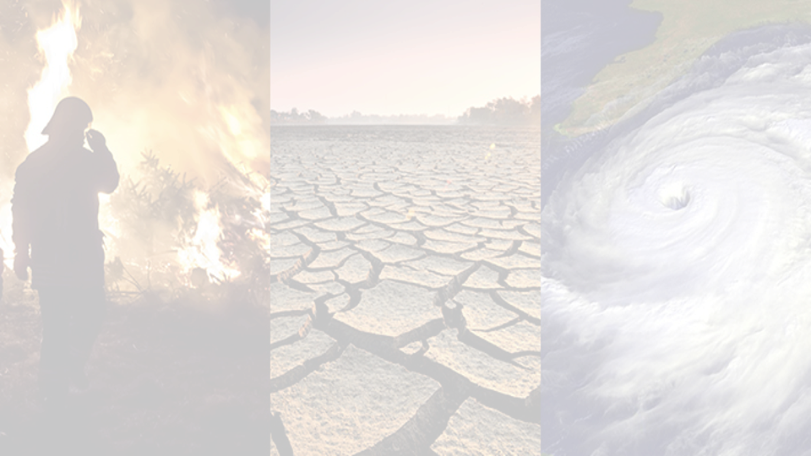
The science of climate change, and our economic system’s current reliance on fossil fuels
November 2020
Prof Brendan Mackey, Director
Griffith Climate Action Beacon
Source: NASA

Slide 2
Outline
What are fossil fuels and why are they a problem?
How have fossil fuels powered the industrial revolution and economies today?
What are the impacts of anthropogenic climate change?
The ​Paris Agreement commitments and the current emission gap

Slide 3
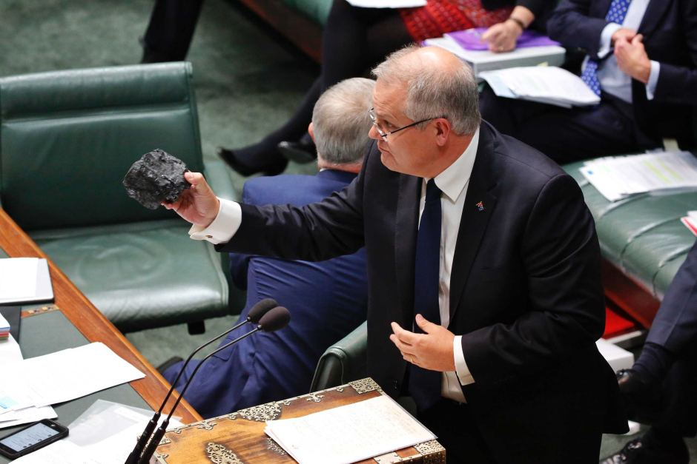
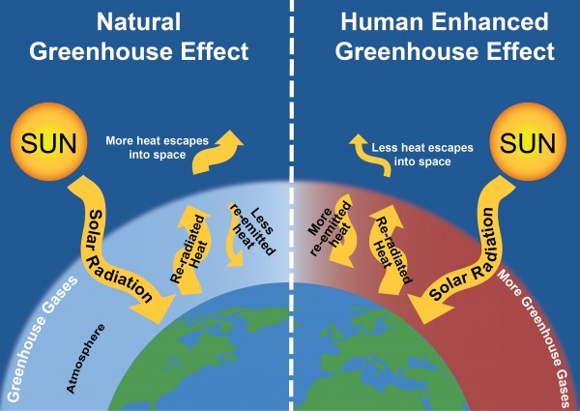
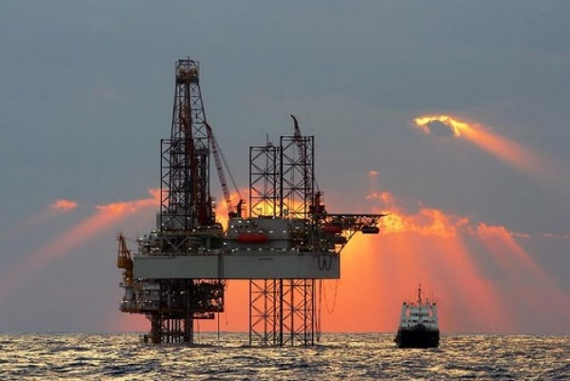
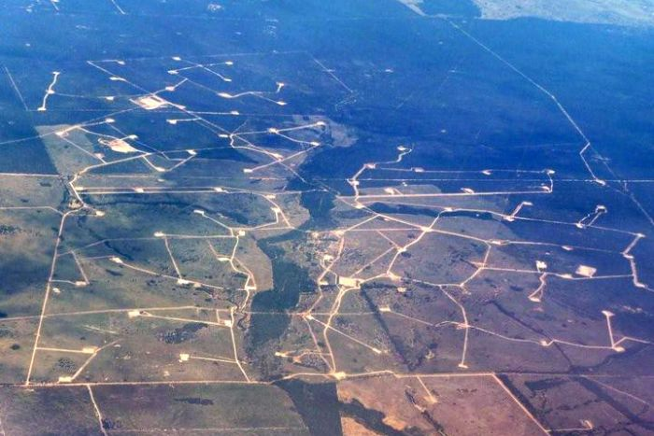
When fossil fuels are burned to generate power, carbon dioxide and other greenhouse gases are released into the atmosphere, and through “radiative forcing” increasing the heat energy stored in the atmosphere and oceans, driving global climate change and disrupting oceanic processes
What is fossil fuel & why is it a problem?
Coal: sedimentary rock formed during the Carboniferous period (300–360 mya) from plant biomass
Oil: Crude oil is a liquid composed of carbon and hydrogen, formed during the Mesozoic period (252-66 mya) from plant biomass
Natural gas: An odorless gas composed primarily of methane, also from mya from decaying plant biomass
Sources: http://css.snre.umich.edu/factsheets/climate-change-science-and-impacts-factsheet; www.abc.net.au

Slide 4
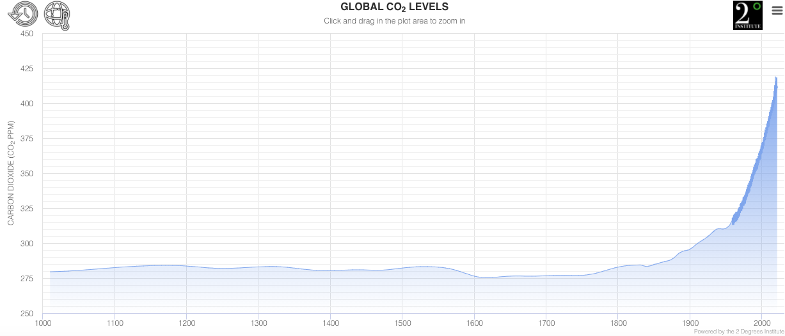
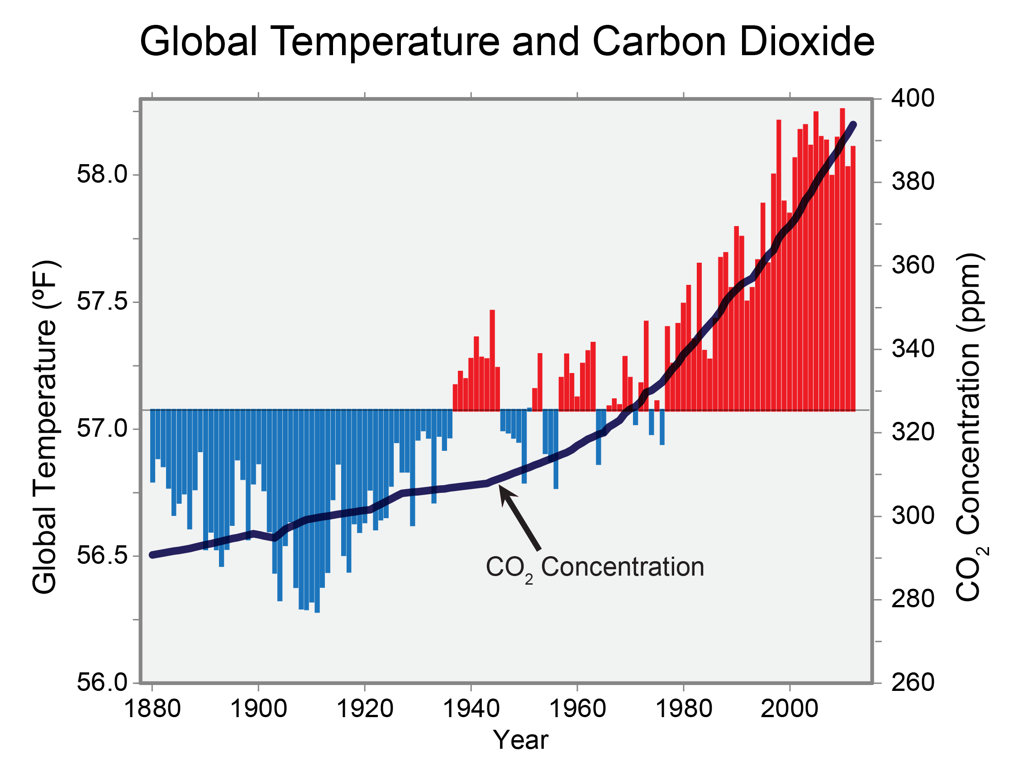
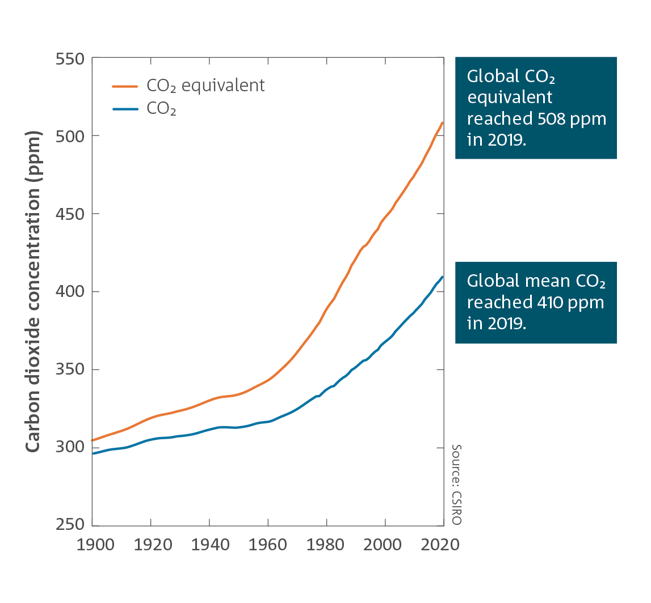
Source: epa.gov.us; https://www.co2levels.org/; CSIRO/BOM State of the Climate 2020

Slide 5
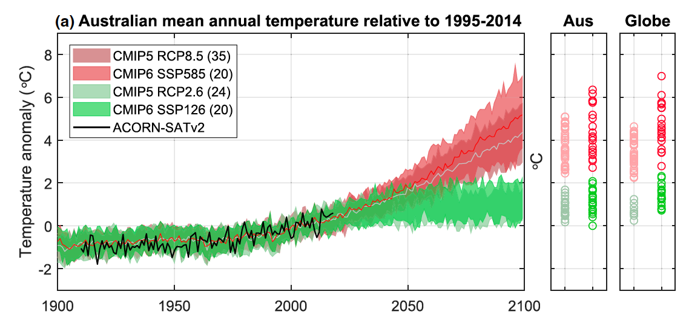
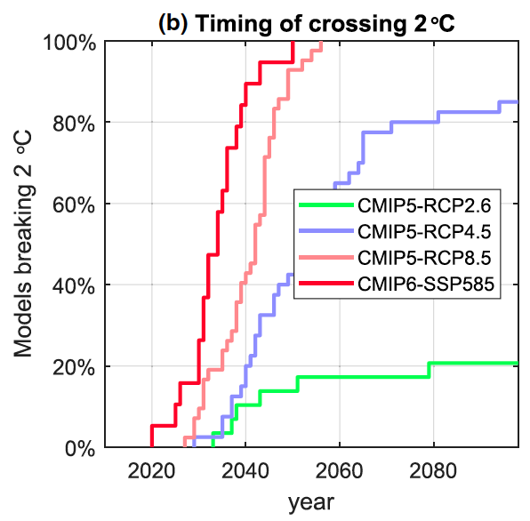
Success / failure to mitigation GHG emissions determines level of global warming
Source: Grose et al. 2020
https://doi.org/10.1029/2019EF001469

Slide 6
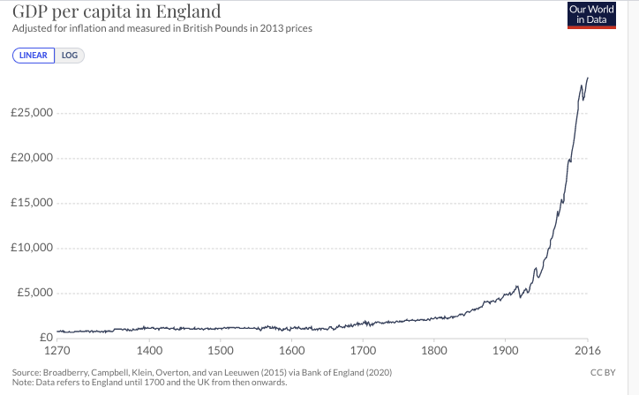
The pre-growth economy was a zero-sum-game: Living standards were determined by the size of the population

Slide 7
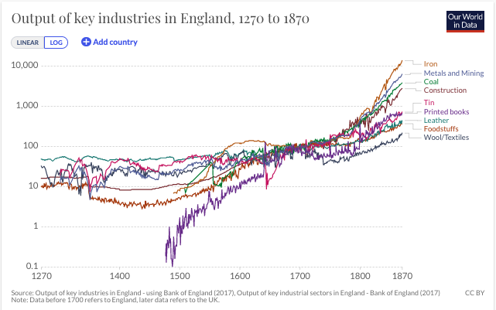
Source: Max Roser (2013) - "Economic Growth". Published online at OurWorldInData.org. Retrieved from: 'https://ourworldindata.org/economic-growth' [Online Resource]

Slide 8
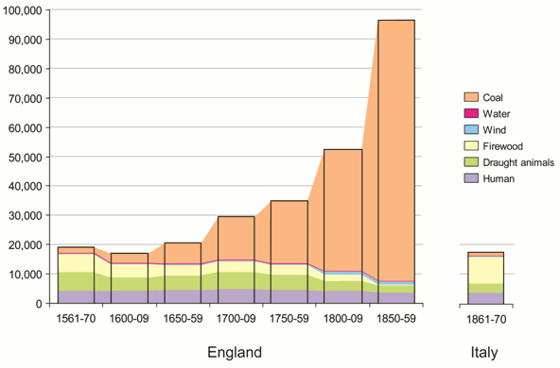
Source: Wrigley, EA (2010), Energy and the English industrial revolution, Cambridge University Press.

Slide 9
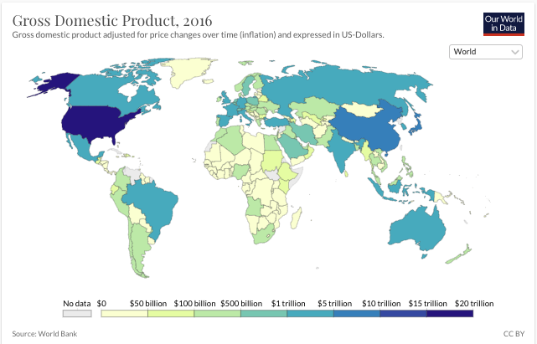

Slide 10
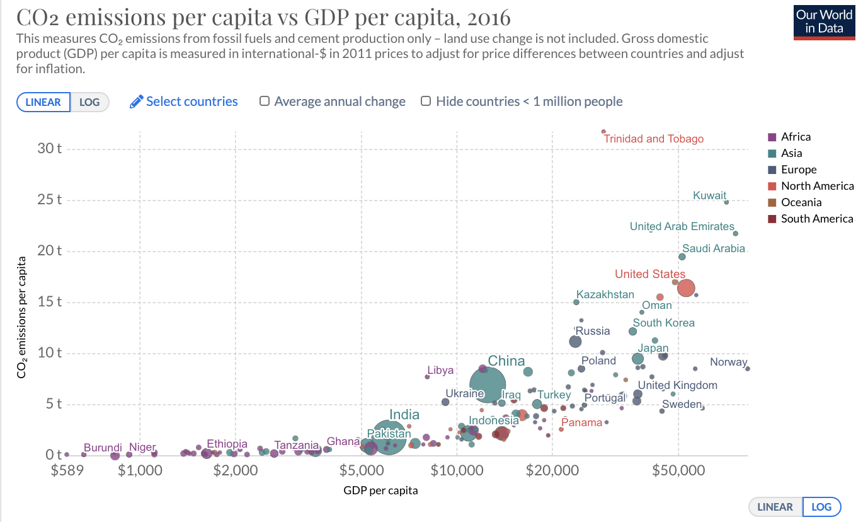

Slide 11
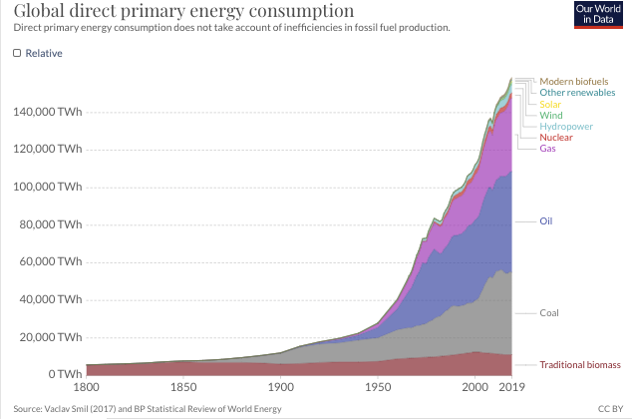

Slide 12
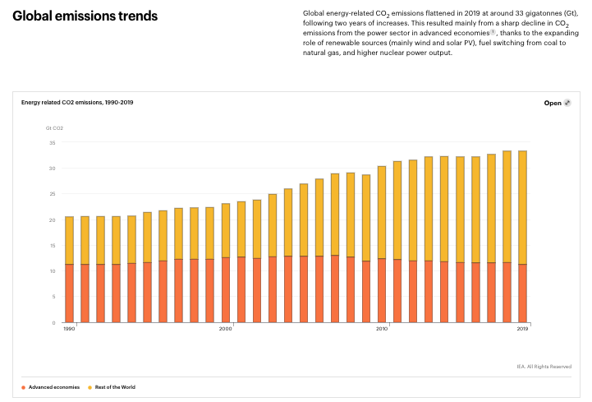
Advanced economies
Rest of the world
Source: IEA

Slide 13
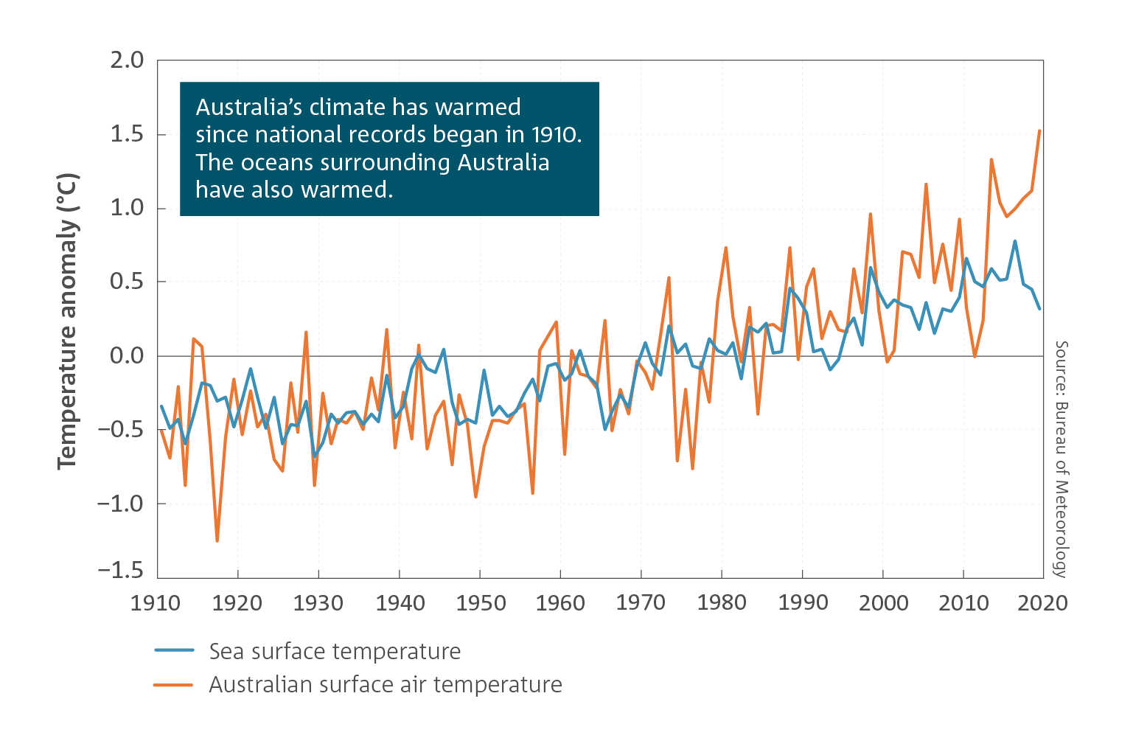
We have had 1 °C of global warming since pre-industrial levels (1.5 °C on land)

Slide 14
In Australia , 1 °C of global warming has resulted in, among other things:
a new ‘catastrophic’ fire danger category and forest mega fires
a 5-fold increase in heat waves events
30% of coral within shallow-water reefs of GBR killed by temperature-driven bleaching events in 2016 and 2017
many regions – including in Queensland – experiencing unprecedented extreme climatic events
a 20% decrease in rainfall in southern and eastern Australia
We are now having national discussions about which regional towns may have be abandoned due to zero water, and
the insurance industry is identifying 'red zones'

Slide 15
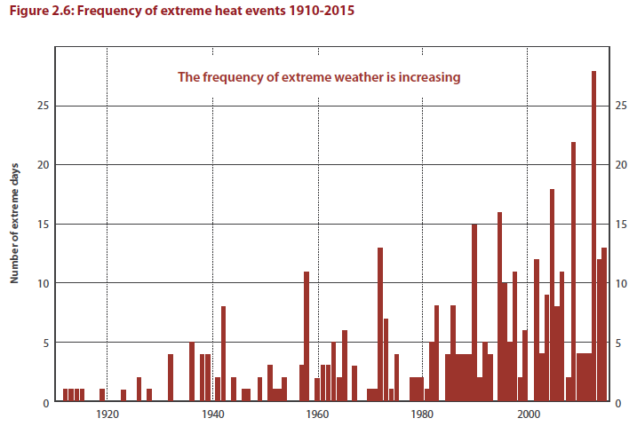
Observed change in extreme heat events from 1 degree of global warming
Number of days each year where the Australian area-averaged daily mean temperature is extreme. Extreme days are those above the 99th percentile of each month from the years 1910–2017. These extreme daily events typically occur over a large area, with generally more than 40 per cent of Australia experiencing temperatures in the warmest 10 per cent for that month
Source: Bureau of Meteorology, State of the Climate 2016

Slide 16
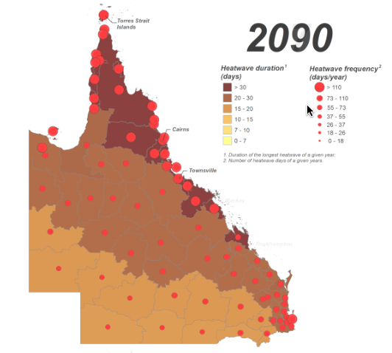
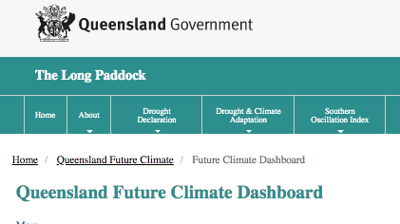
Projected heatwaves 2090 if business-as-usual emissions continue

Slide 17
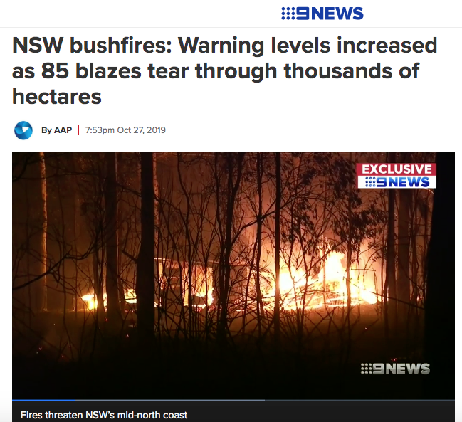
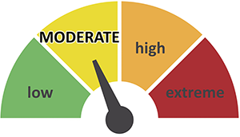
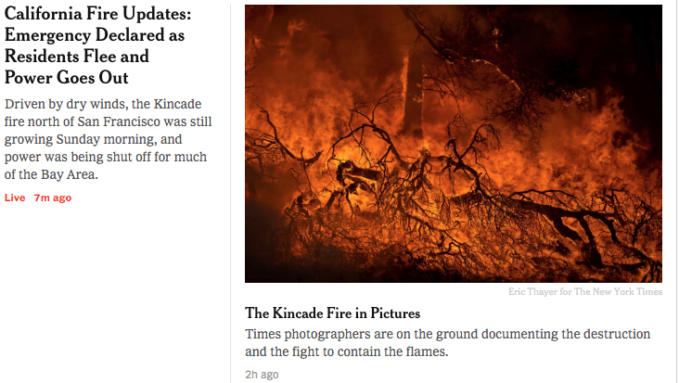
Fire danger escalating
Old fire danger ratings
New fire danger ratings
Scaled 0-100 in 1970’s
Now, index value >>100

Slide 18
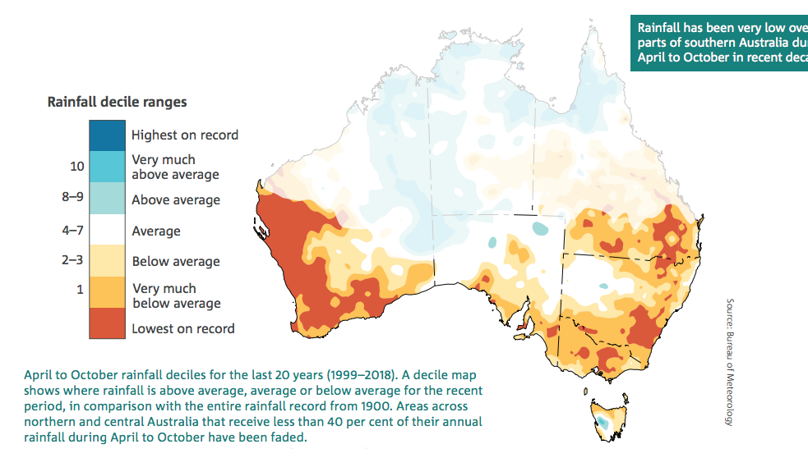
Observed change in rainfall
Source: Bureau of Meteorology, State of the Climate 2016, page 7

Slide 19
How will rainfall change in the future?
As the climate warms, heavy rainfall is expected to become more intense, based on the physical relationship between temperature and the water-holding capacity of the atmosphere
For heavy rain days, total rainfall is expected to increase by around 7 per cent per degree of warming
For short‑duration, hourly, extreme rainfall events, observations in Australia generally show a larger than 7 per cent increase
Short-duration rain extremes are often associated with flash flooding
(Source: Bureau of Meteorology, State of the Climate 2016, page 8)

Slide 20
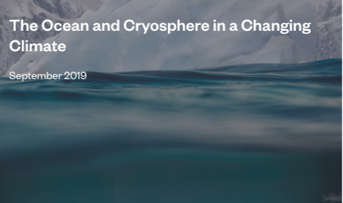
Ocean: Projected future impacts
Marine heatwaves and extreme El Niño and La Niña events are projected to become more frequent. Climate models project increases in the frequency of marine heatwaves by 2081–2100, relative to 1850–1900, by approximately 50 times under RCP8.5
Sea level continues to rise at an increasing rate. Extreme sea level events that are historically rare (once per century in the recent past) are projected to occur frequently (at least once per year) at many locations by 2050 in all RCP scenarios, especially in tropical regions
Extreme sea levels and coastal hazards will be exacerbated by projected increases in tropical cyclone intensity and precipitation​
A decrease in global biomass of marine animal communities, their production, and fisheries catch potential, and a shift in species composition are projected over the 21st century in ocean ecosystems. The rate and magnitude of decline are projected to be highest in the tropics

Slide 21
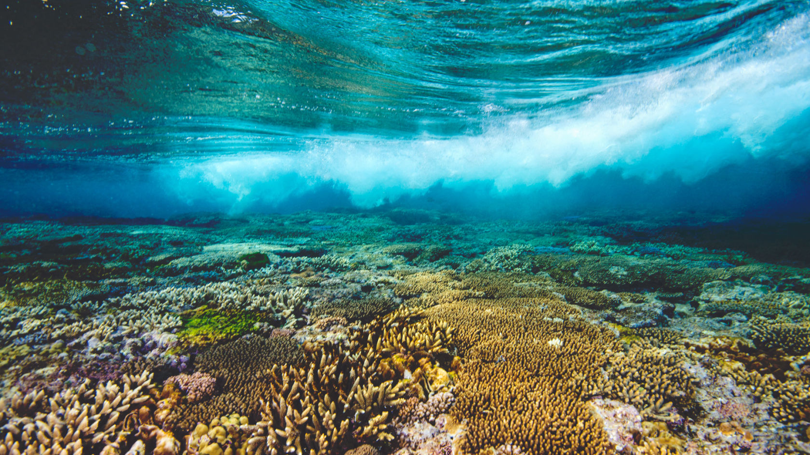
Impacts on warm water, shallow coral reefs
If the current warming rate continues, the world would reach human-induced global warming of 1.5°C around 2040
Coral reefs are projected to decline by a further 70–90% at 1.5ºC (high confidence) with larger losses (>99%) at 2ºC (very high confidence)
GBR Employ 63,000 people, bring $6.4B to economy and has an asset value of $56B
Sources:
IPCC 1.5 Degree Special Report
Deloitte Access Economics 2017
Image: Great Barrier Reef Foundation

Slide 22
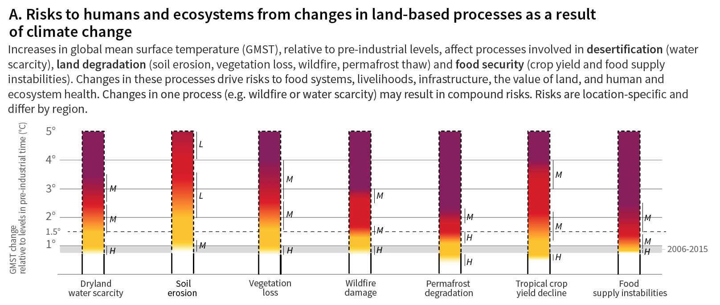
Source: IPCC special report on climate change and land; https://www.ipcc.ch/site/assets/uploads/sites/4/2020/02/SPM_Updated-Jan20.pdf

Slide 23
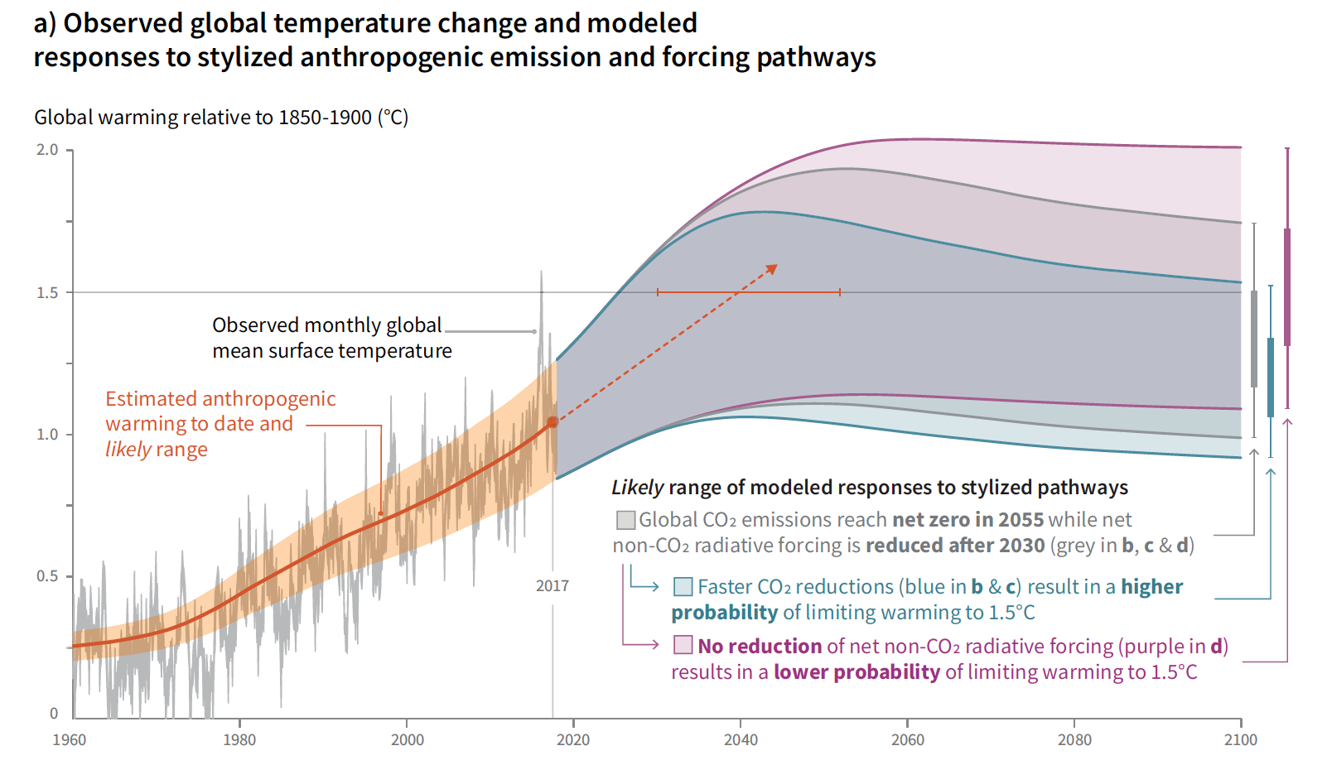
Source: IPCC special report on 1.5 degrees of global warming; https://www.ipcc.ch/sr15/

Slide 24
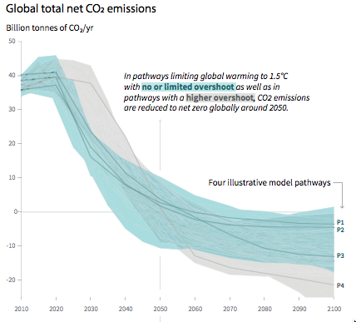
The mitigation imperative
For limiting global warming to 1.5 °C, CO2 emissions must be reduced by 45-50% by 2030 and net zero around 2050
Pathways limiting global warming to 1.5°C require rapid and far-reaching transitions in energy, land, urban and infrastructure (including transport and buildings), and industrial systems
These systems transitions are unprecedented in terms of scale, but not necessarily in terms of speed, and imply deep emissions reductions in all sectors

