Slide 1
Problems and solutions in housing

Slide 2
Overview
Problem #1: The Man of Property and suburban unsustainability
Problem #2: housing as a commodity
New (and old) alternatives
Housing as a commons

Slide 3
1. Problem #1
Previously I talked about property as exclusionary and as hiding or marginalising non-owners
Val Plumwood (1995, p.100) describes the archetype of humanity upheld in westernised ideas of property:
“The Man of Property constitutes as excluded a certain range of others because the concept of property has built into it the denial and appropriation of certain backgrounded kinds of prior contribution or labour, and requires the continued representation of this contribution as inessential and the subsumption of those who make it within the master's sphere of ends.”
So property ownership does not just refuse to see or acknowledge others; it also appropriates their labour
So, what labour?

Slide 4
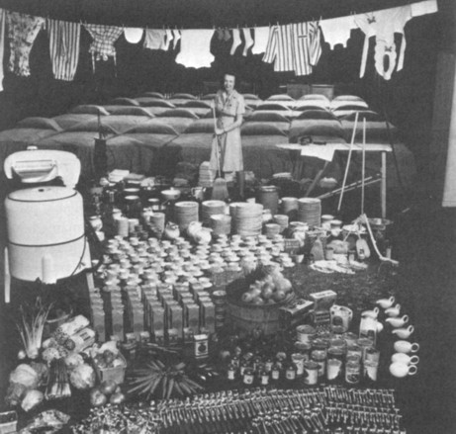
1. Problem #1
well, there’s actual labour

Slide 5
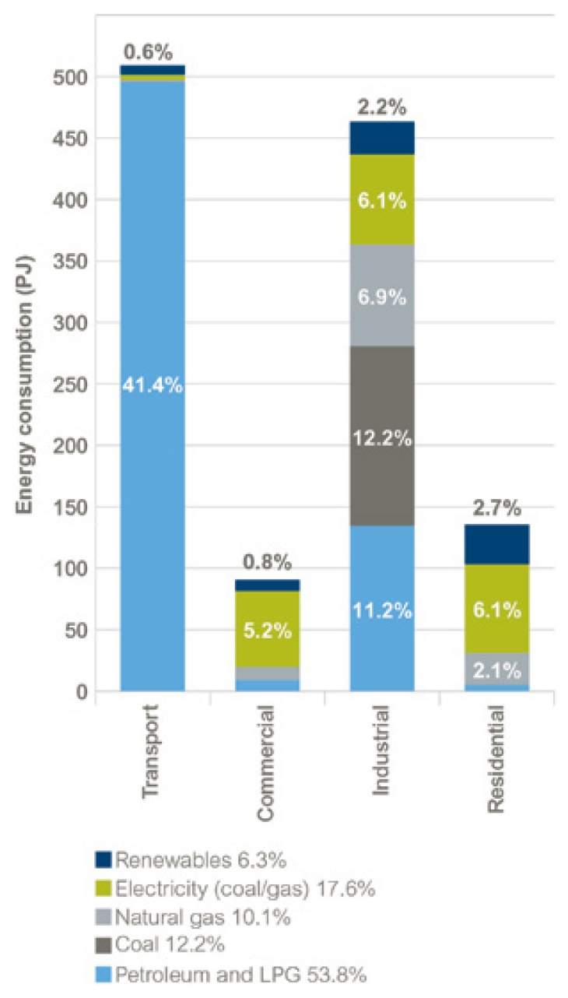
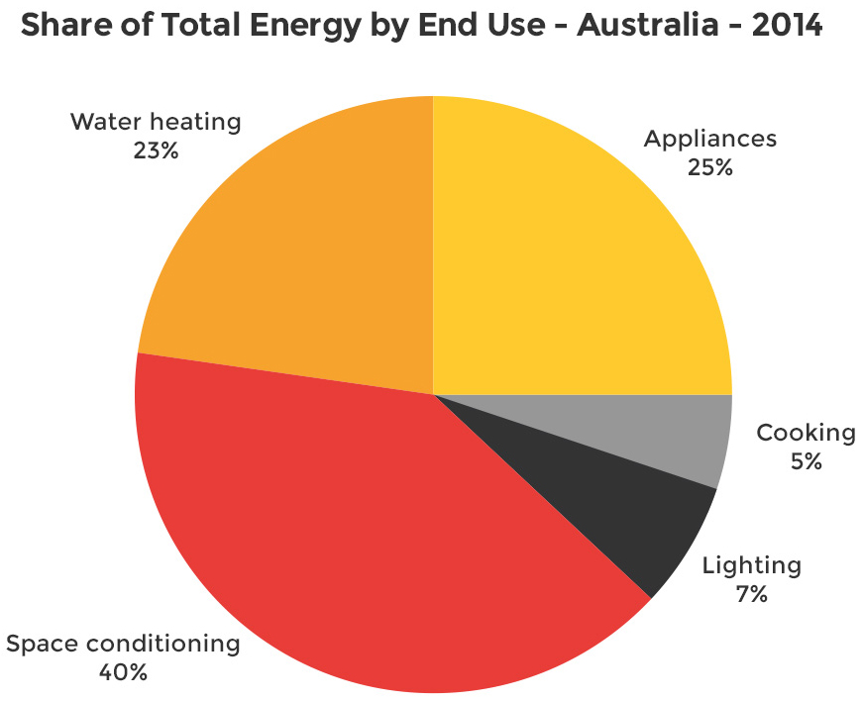
1. Problem #1
and water and energy slaves…

Slide 6
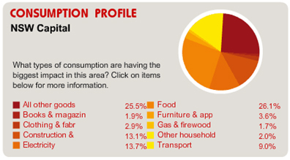
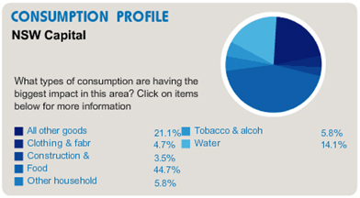
1. Problem #1
Food plus ‘all other goods’ dominate all consumption patterns
Notes:
Food plus ‘all other goods and services’ are main components of household energy and water profiles.
Conundrum of fixating on efficiencies – rebound effect as extra cash can mean more consumption (Murray, 2013).

Slide 7
1. Problem #1
Young (1997: 143) states
"the goal of a dream house sets workers working and keeps workers working“
Industrialists on record asserting that the demands of home maintenance would undermine and counter union organising
So there’s real and virtual labour – all those energy slaves hidden behind fossil fuel usage and water supply
But wait, there’s more:
"Both union leaders and manufacturers agreed that a more spacious, mass-produced form of housing was essential to enable workers and their families to consume" (Hayden 1984: 33).

Slide 8
1. Problem #1
Post war suburban houses required and reinforced a male breadwinner and a female home-keeper
Design focused on replication of individual spaces of domestic labour in each house, reinforced conservative mindsets and provided markets for post-war industrialists
Suburban housing provided both the labour for manufacturing and the consumption base to drive the manufacturing, so a work-consume nexus developed
This was largely driven by the oil industry, meaning…

Slide 9
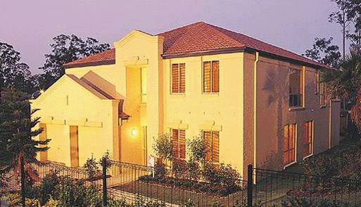
1. Problem #1
“a box to be filled with commodities” - Hayden (1980: 174)
with no concern for, or awareness of, the resource base

Slide 10
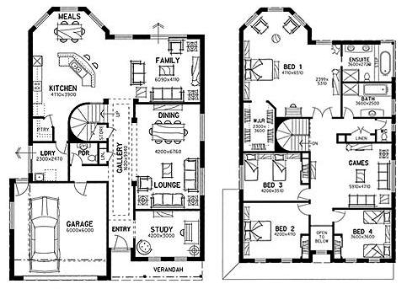
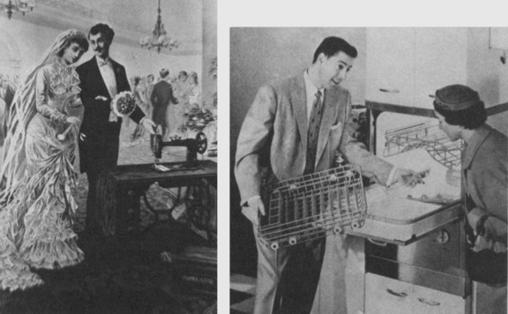
405m² of suburban dreaming
Internalisation of formerly public life; requirement for domestic (unpaid) labour; setting the conditions for social competitiveness

Slide 11
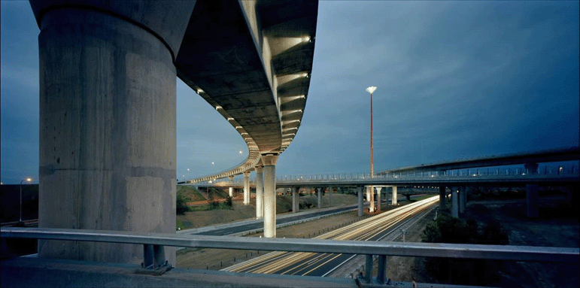
And how do we get there?
http://www.westlinkm7.com.au/

Slide 12
1. Problem #1
terrain of consumption: food, water, housing, transport, “all other goods and services”
role of inbuilt and perceived obsolescence
playing on fact that we are social creatures
impacts of perception of low relative social ranking on mental and physical wellbeing, once environmental and other variables accounted for (Wilkinson 2000)
so, sub/urban form predicated on economic basis that is physically unsustainable and makes us sick

Slide 13
2. Problem #2
Community
Industry
Government
Market "Investors"
Government
"Community"
Deliberative
Citizen-led
Speculative
Developer-Led
Notes:
Traditional forces: geography, geology, technology, climate, culture, population - less traditional: market, commerce, politics and governance, industry,
Speculative vs collaborative

Slide 14
2. Problem #2
Not only a box to be filled with commodities, but a commodity in itself
Focus on home ownership is a recent political and policy phenomenon in Australia
Underpinned by economic and population growth of the 1950s onwards and development of suburbs
Changes to policy setting – shift from subsidisation of public housing to private
owner-occupiers >$8,000 per household per year;
investors (most of whom are also owner-occupiers) >$4,000 per household per year; and
renters just over $1,000 per year.
(Yates 2009)

Slide 15
2. Problem #2
2016 Census
Reduction in homeownership rates since the 1980s
Renting as a growing proportion of Australian households
On par with outright ownership
Anglicare rental affordability snapshots
Worsening outcomes year on year

Slide 16
 |  | 2015 |  | 2020 |  | 2020 with COVID supplement
Household Type | Payment type | No. affordable & appropriate | % affordable & appropriate | No. affordable & appropriate | % affordable & appropriate | No. affordable & appropriate | % affordable & appropriate
Couple, two children (one aged less than 5, one aged less than 10) | Newstart Allowance (both adults) | 618 | 0.9 | 589 | 0.8 | 8,106 | 11.6
Single, two children (one aged less than 5, one aged less than 10) | Parenting Payment Single | 165 | 0.3 | 321 | 0.5 | 1,798 | 2.6
Couple, no children | Age Pension | 2,239 | 3.4 | 1,898 | 2.7 | 2,212 | 3.2
Single, one child (aged less than 5) | Parenting Payment Single | 548 | 0.8 | 395 | 0.6 | 2,109 | 3
Single, one child (aged over 8) | Newstart Allowance | 84 | 0.1 | 71 | 0.1 | 1,187 | 1.7
Single | Age Pension | 593 | 0.9 | 526 | 0.8 | 743 | 1
Single aged over 21 | Disability Support Pension | 317 | 0.5 | 245 | 0.4 | 326 | 0.5
Single | Newstart Allowance | 10 | <0.1 | 9 | 0 | 1,040 | 1.5
Single aged over 18 | Youth Allowance | 8 | <0.1 | 3 | 0 | 624 | 0.9
Single in share house | Youth Allowance | 8 | <0.1 | 3 | 0 | 484 | 0.7
Couple, two children (one aged less than 5, one aged less than 10) | Minimum Wage + FTB A (both adults) | 15,605 | 23.8 | 15,373 | 22 | 15,373 | 22
Single, two children (one aged less than 5, one aged less than 10) | Minimum Wage + FTB A & B | 2,186 | 3.3 | 2,723 | 4 | 2,723 | 3.9
Single | Minimum Wage | 1,501 | 2.3 | 1,688 | 2.4 | 1,688 | 2.4
Couple, two children (one aged less than 5, one aged less than 10) | Minimum Wage + Parenting payment (partnered) + FTB A & B | 4,501 | 6.9 | 4,455 | 6.4 | 10,272 | 14.7
Total available rentals |  | 65,614 |  | 69,960
Figures from Anglicare rental affordability snapshot, 2015 and 2020
Notes:
2015 data

Slide 17
2. Problem #2
Systemic flaws highlighted by COVID
Rough sleepers
Formal numbers are almost certainly an undercount; also those on the margins – couchsurfing, sleeping in cars, etc.
Rental stress
More than 1m households in rental stress; many will have lost their jobs and be facing removal of COVID supplements
Reduced social housing system
Relative to population, no. of social housing properties halved since 1991
Debt
Debt: income ration is 190%, due to mortgage borrowing
Unbalanced and fragile system
Vulnerable to market shocks due to dominance of private developers

Slide 18
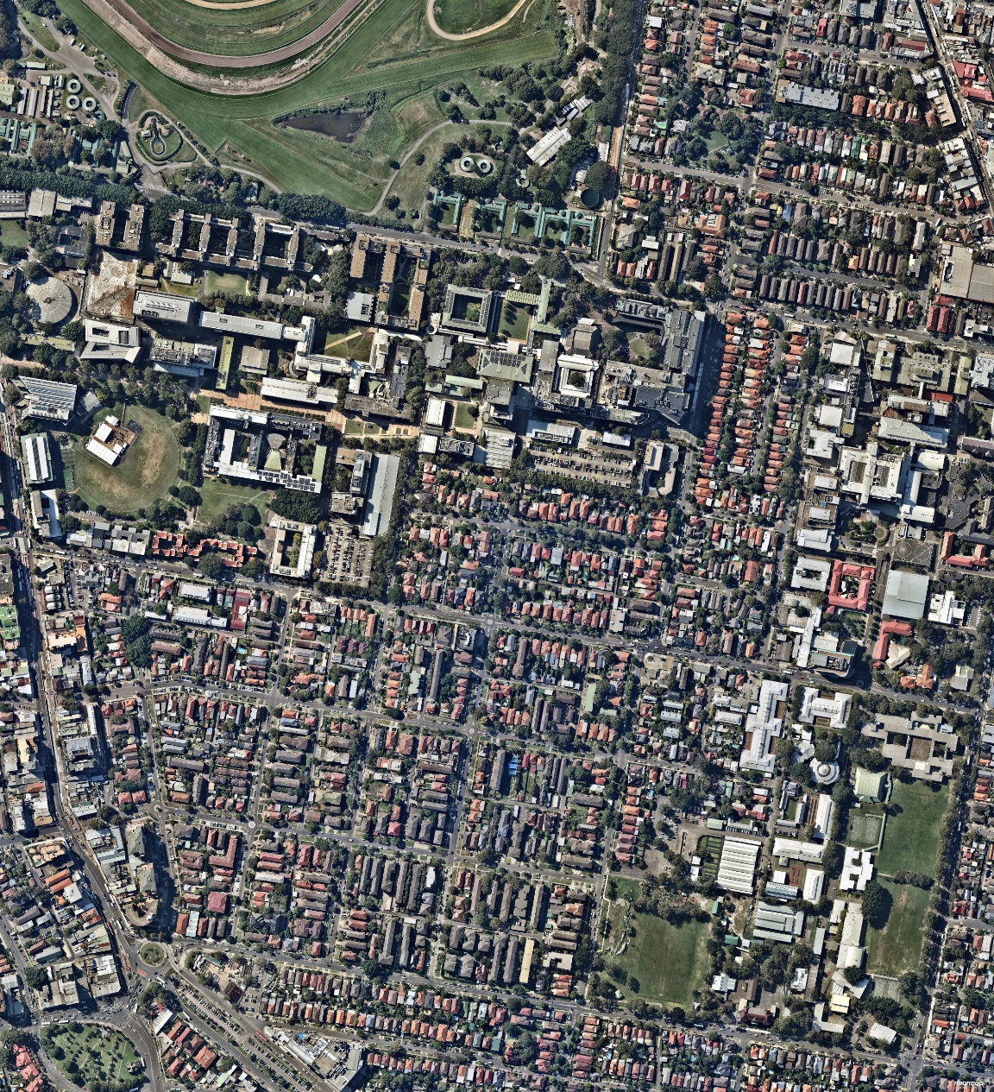
2. Problem #2
Example: Randwick
Bought in 2006 for $6m
Sold on in 2015 with DA consent for $290m
$184m value uplift or 4,874%
DA approved for 750 dwellings
Thanks to Bill Randolph

Slide 19
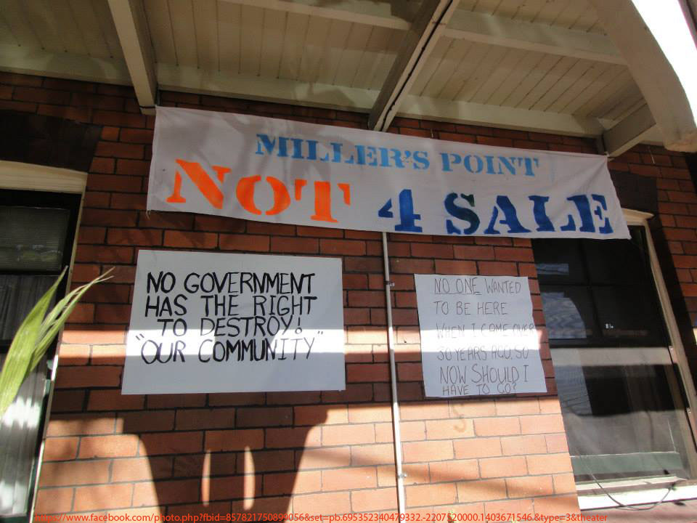
3. New (and old) alternatives
Key policy changes needed
Move from stamp duty to land tax
Reduce incentives for landlordism
More affordable housing paid by #2
Institutional funding of affordable housing
Permanently affordable ownership schemes
Mandated affordable housing targets
Upgrade and expand public housing
https://theconversation.com/tackling-housing-unaffordability-a-10-point-national-plan-43628
https://theconversation.com/coronavirus-lays-bare-5-big-housing-system-flaws-to-be-fixed-137162

Slide 20
3. New (and old) alternatives
Build-to-rent – entire apartment block built to be rented out by single entity; under consideration in NSW but research suggests it is unviable without subsidies and should involve a community housing provider (CHP).
Cohousing – smaller units, substantial shared amenities. Often formed by communities of interest. May or may not include an affordability component.
Coliving – small apartments with shared facilities; developer-led. Not generally a specific affordable product; rent at what market will bear.
Community land trusts – land value is held out of the market by a non-profit; residential and broader community governance. Provide permanent affordability and community benefit; diverse portfolios to address local need
Community-led housing – umbrella term for any form led by community – e.g., cooperatives, community land trusts, self-build

Slide 21
3. New (and old) alternatives
Cooperatives – residents own shares instead of the homes; residential community governance. Can be affordable rental, limited equity, or market-rate ownership. Can generate better design and social outcomes
Deliberative development – future residents working directly with developer; may or may not have an affordability component. Tends to be ‘sub-market’.
Ecovillages – intentional communities with strong community and environmental focus
Micro-apartments – as with coliving, but smaller; might not have shared facilities
Shared equity – resident co-owns the home with another party. Some programs run by government, some run by non-profit CHPs. May or may not involve ongoing affordability requirements
Tiny homes – small, self-contained homes; semi-mobile. Mainly lifestyle choice but some usage in affordable housing.

Slide 22
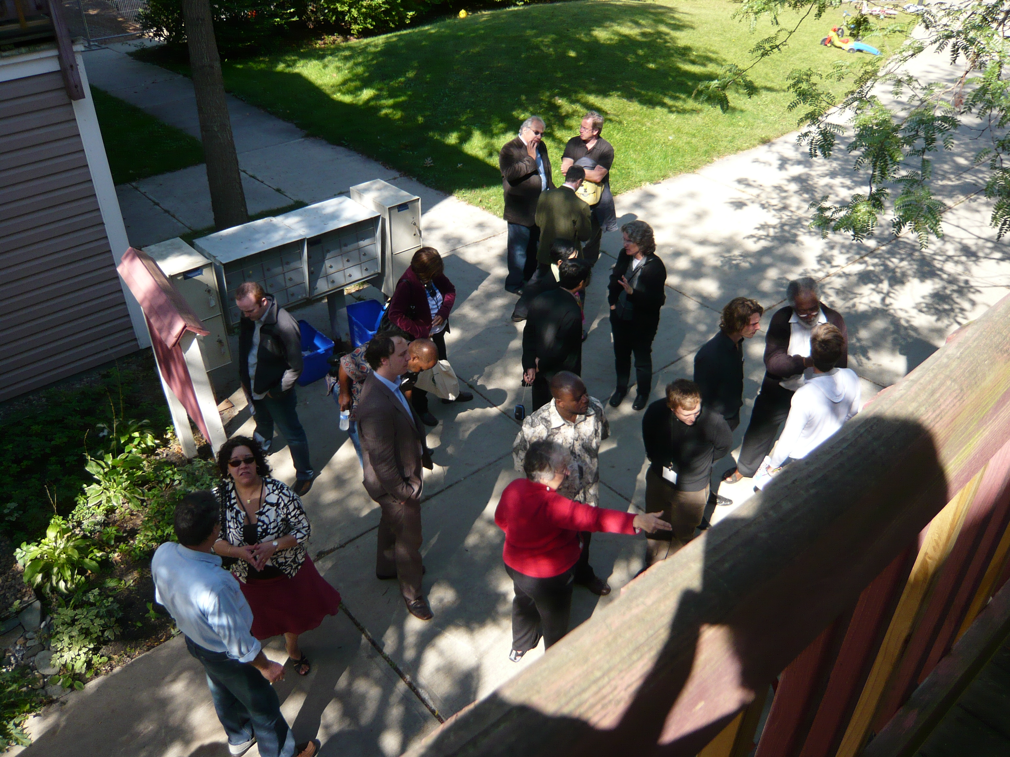
4. Housing as a commons
Commoning
Involves establishing patterns and conventions for:
Access
Use
Benefit
Care
Responsibility

Slide 23
4. Housing as a commons
Housing Cooperatives – common ownership structure
Residents in housing (can be apartments and/or houses) collectively hold title to and manage their building via a member-based cooperative
Larger ones can employ staff to manage tenancies, repairs, etc.
Each resident owns a share in the cooperative
Share value may be nominal, limited, or market rate
Residents pay rent, admin fee, or carrying charge to the cooperative
Has clear delineation of the system, its members, rules of use and access
Challenges:
Can experience burnout if at small scale
Members might decide to sell stock at market rate in previously affordable stock; prevention needs oversight

Slide 24
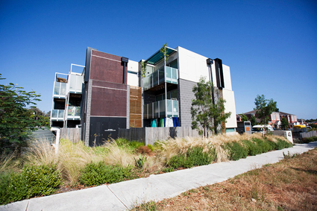
4. Housing as a commons
Housing Cooperatives – Murundaka Cohousing, Melbourne
Community rental, rents indexed to income
Title lies with Common Equity Housing Ltd; private non-profit
High environmental standards
Rooftop solar, solar passive
Rainwater collection and storage
Shared gardens
Shared kitchen, dining/meeting room, guest/music room
Tenure form and lifestyle choice

Slide 25
4. Housing as a commons
Community Land Trusts (CLTs)
Private non-profit organisations (usually corporations) holding property in perpetuity to provide
Permanently affordable housing; and
Community benefit
Each CLT defines these according to context – immense variability and diversity in stock and programs
Initial focus was collective, de-commodified ownership of land
Growing literature on CLTs as commons

Slide 26
4. Housing as a commons
Community Land Trusts (CLTs)
Classic Board structure: 1/3rd residents, 1/3rd non-resident members, 1/3rd representatives of the ‘public at large’, appointed by the other 2/3rds
Balances rights and responsibilities of household and community, including future
Can prevent NIMBYism, resident sell-offs, and heavy-handed policy
Affordability retained through legal mechanisms – leases, deeds, etc.
Legal mechanisms clarify rules regarding access and use as determined by operational staff under Board oversight
Are a hybrid community development and affordable housing model – “developers that don’t go away?

Slide 27
4. Housing as a commons
Dudley Street Neighbourhood Initiative, Boston MA
Community-based planning and organising entity
“a collaborative effort of over 3,000 residents, businesses, non-profits and religious institutions members ” (http://www.dsni.org/history.shtml)
Board of 34 across diverse groups, including youth
Established a community land trust to develop and deliver affordable housing
Have overseen development of 225 units of perpetually affordable homes by their CLT, plus over 1,300 local development applications, often with several hundreds members in attendance
DNI’s strategic vision for the area has been adopted by the City as local urban renewal plan

Slide 28
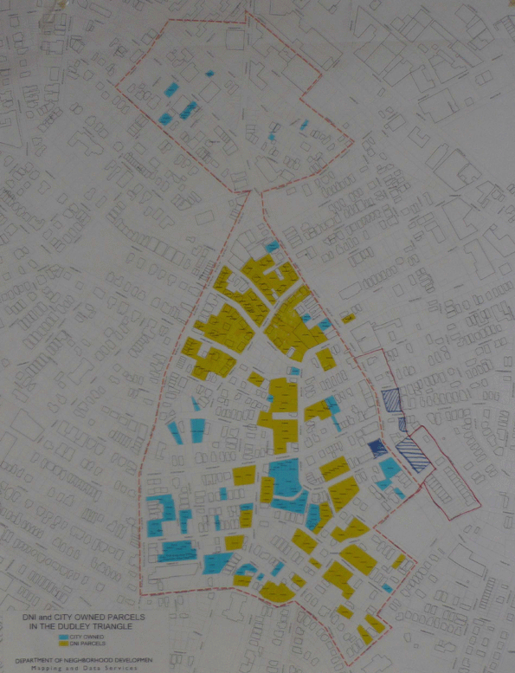
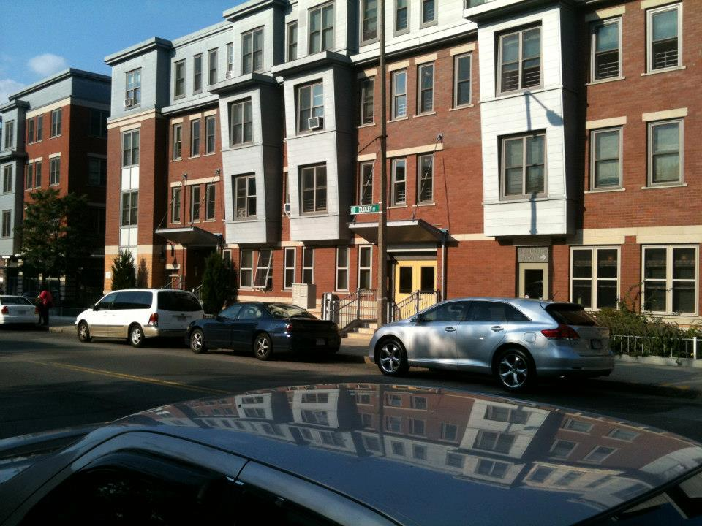
Dudley Street Neighbourhood Initiative, Boston MA

Slide 29
Thanks and a post-script
Hayden, D. (1980). What would a non-sexist city be like? Speculations on housing, urban design, and human work. Signs, 5(3), S170--S187.
Hayden, D. (1984). Redesigning the American Dream: the Future of Housing, Work, and Family Life. New York: W. W. Norton and Company.
Plumwood, V. (1995). Feminism, privacy and radical democracy. Anarchist Studies, 3, 97–120.
Yates, J. 2009. Tax Expenditures and Housing. Research Paper. AHURI, Melbourne
Young, I. M. (1997) Intersecting Voices: Dilemmas of Gender, Philosophy and Policy. Princeton, NJ: Princeton University Press.

Slide 30
4. Housing as a commons
Intersections with public infrastructure and governance
Where does the housing commons end?
Eg., should residents in price-restricted homes pay indexed rates of property tax? What might the implications for public budgets be?
Also highlights State reliance on commodification of property – whether stamp duties or land taxes, these are based on calculations of financial value.
Examples shown are hybrids of common and private spaces or rights – some argue the State should still be involved in governance of the commons

Slide 31
4. Housing as a commons
How replicate or emulate the affective and practical landscapes of commoning?
Commons have been managed on the basis of an immediate, lived, and inherited knowledge of the dynamics and limits of a physical system
Intimate coupling of social and ecological systems: need to create or identify limits in absence of ‘hard’ physical limits highlights a social/political act
Nothing in the systemic/functional analysis of commons that implies equity or justice; these must be overtly stipulated and defined
Re-embedding housing in its physical and social landscape as feminist practice

