Slide 1

Planning for a Network of Circular Economy Villages
New Economy Network Australia
Cities Hub conversation: Net Zero Precincts
21 April 2021
Steven Liaros

Slide 2
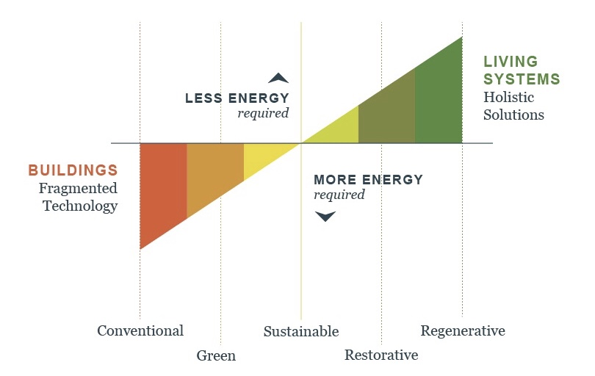
Regenerative development:
From net zero to net positive impact
Trajectory of ecological design
Source: Regenesis, image used with permission
© Bill Reed bill@regenesisgroup.com

Slide 3
Living systems approach: integrate energy, water, food systems, transport with buildings

Slide 4
Our vision
We are planning for a network of high-tech, regenerative villages that strive towards self-sufficiency and zero waste within their bioregion.
Each village will house a diverse community of up to 200 people and will integrate affordable co-working and co-living spaces with water and energy micro-grids and a regenerative agricultural system.
beautilitydevelopments.com.au

Slide 5
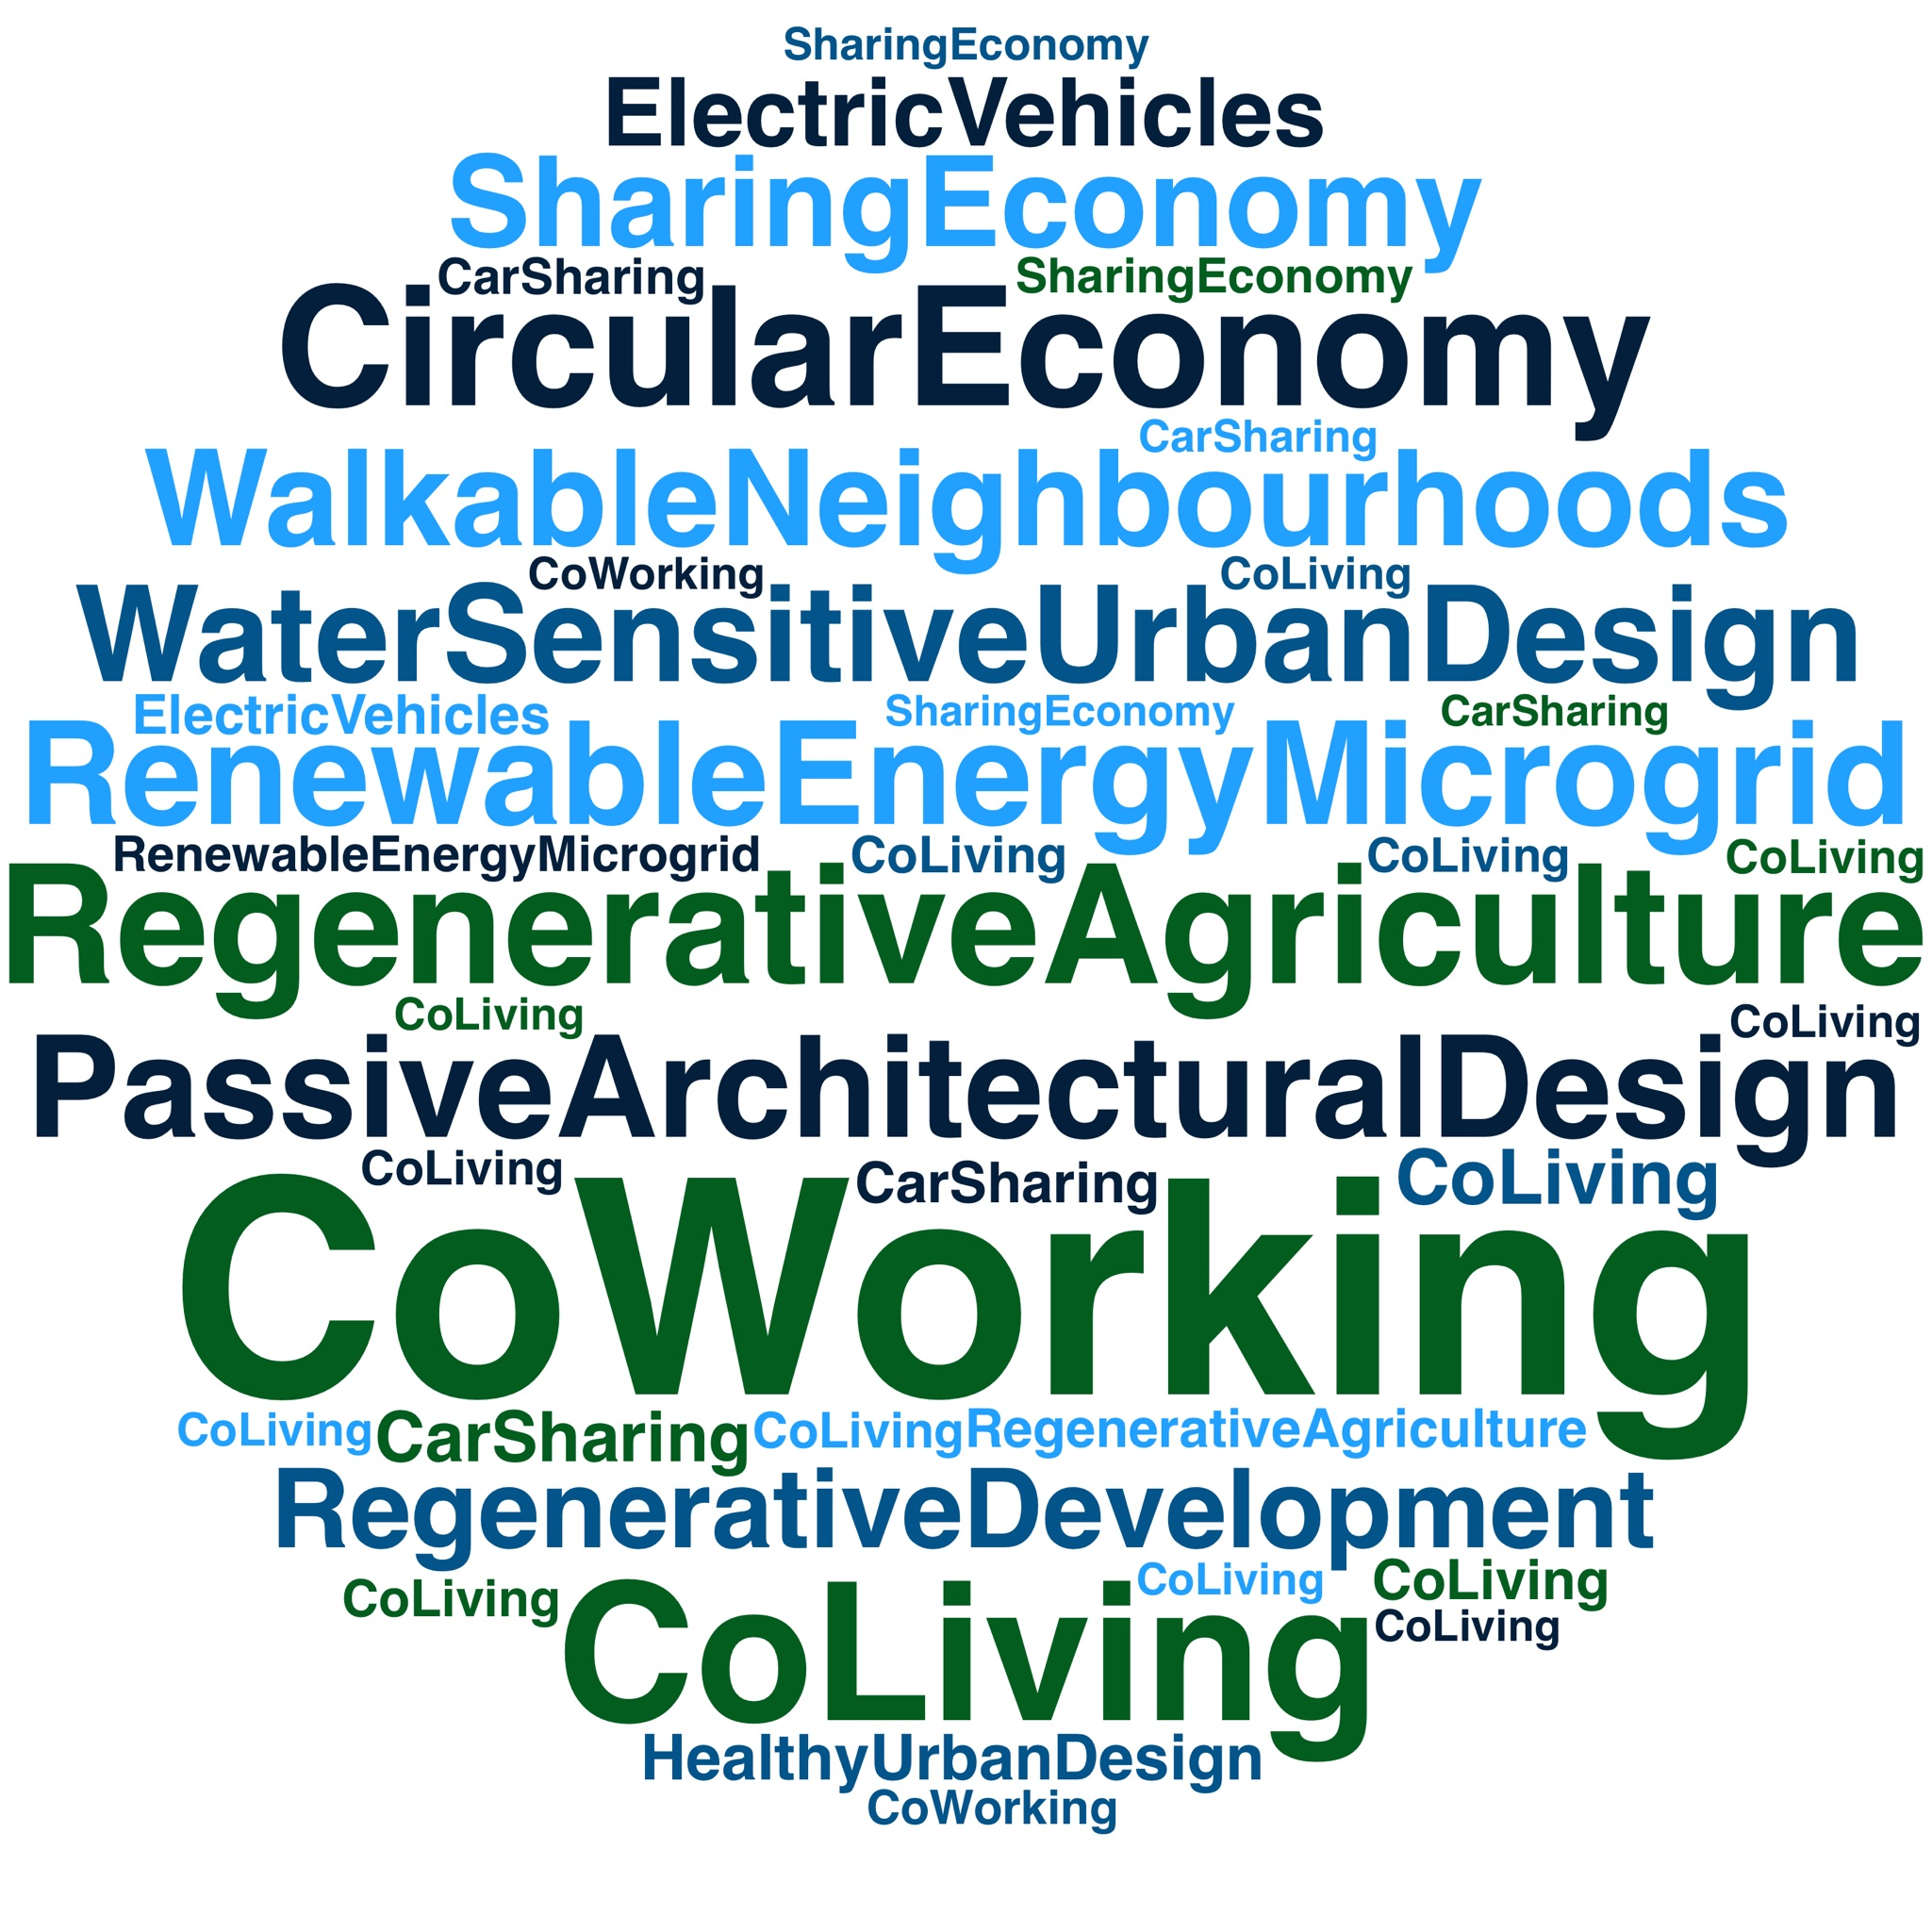
Framework for other solutions & projects

Slide 6
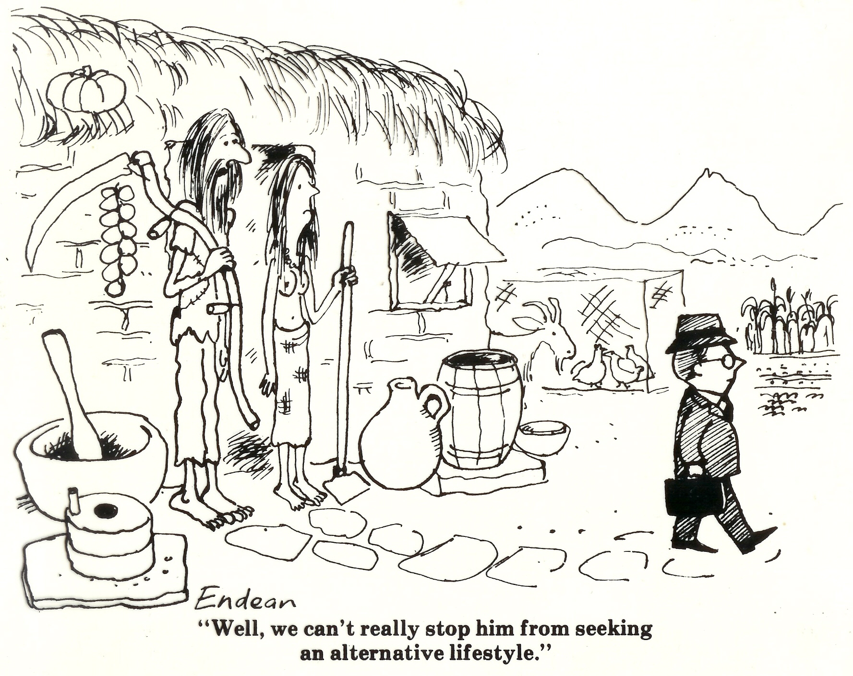
Points of difference
Not planning an individual project but a town planning process
Development approval certainty ensures individual projects can attract required finance.
Not communal living; includes private housing and shared spaces, assets and facilities
Not a return to 17th century agrarian lifestyle; incorporate best available modern technology

Slide 7
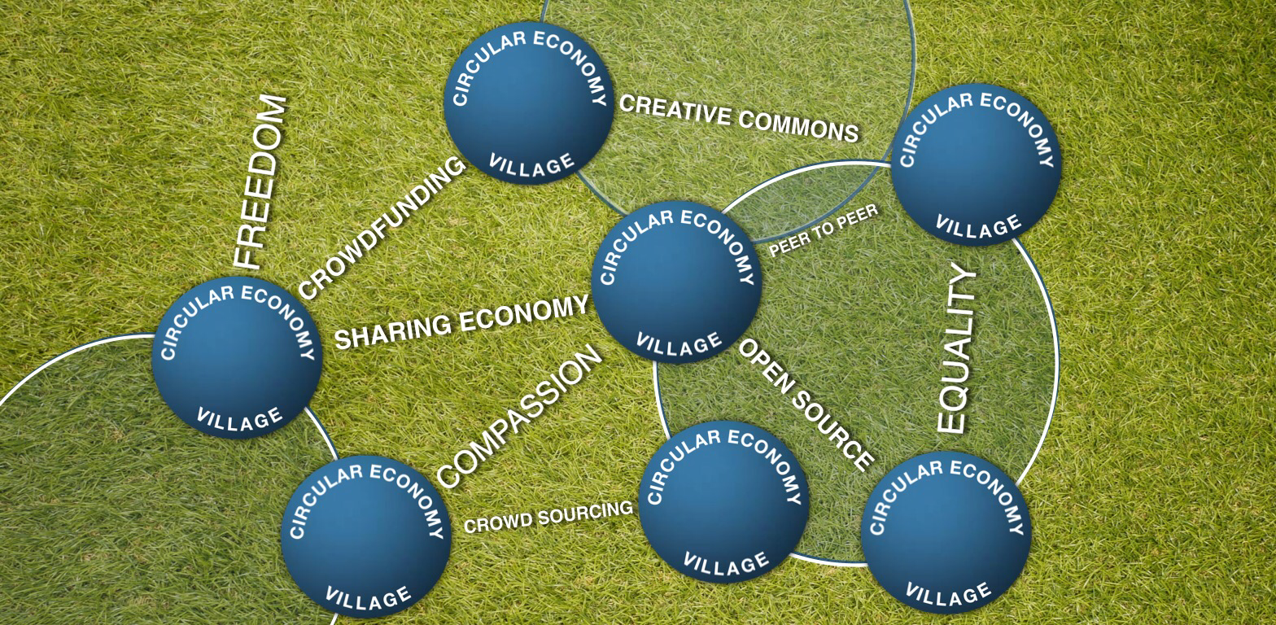
Replicable process for a network of regenerative villages

Slide 8
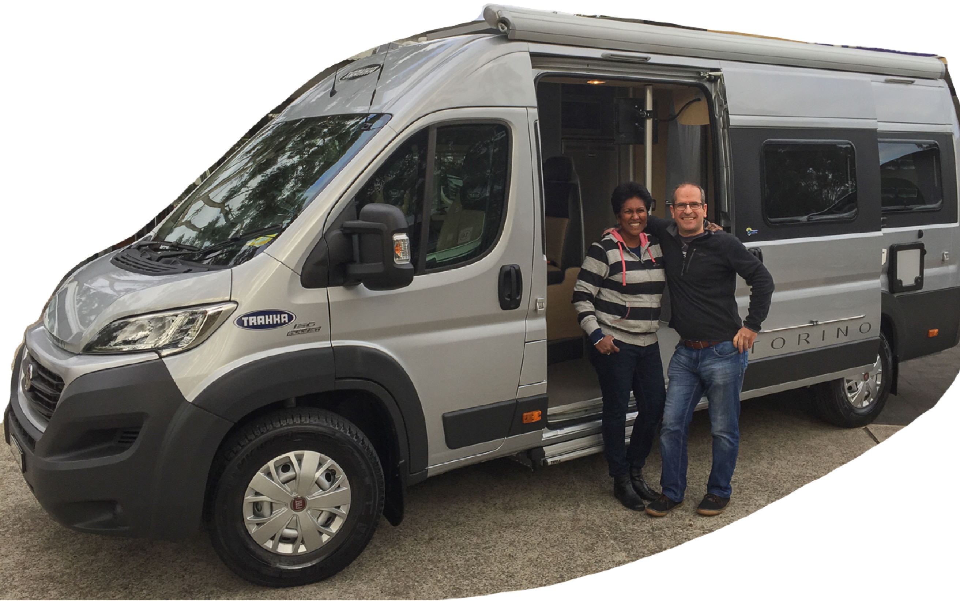
Planning for nomads (digital nomads, grey nomads, vanlifers)

Slide 9
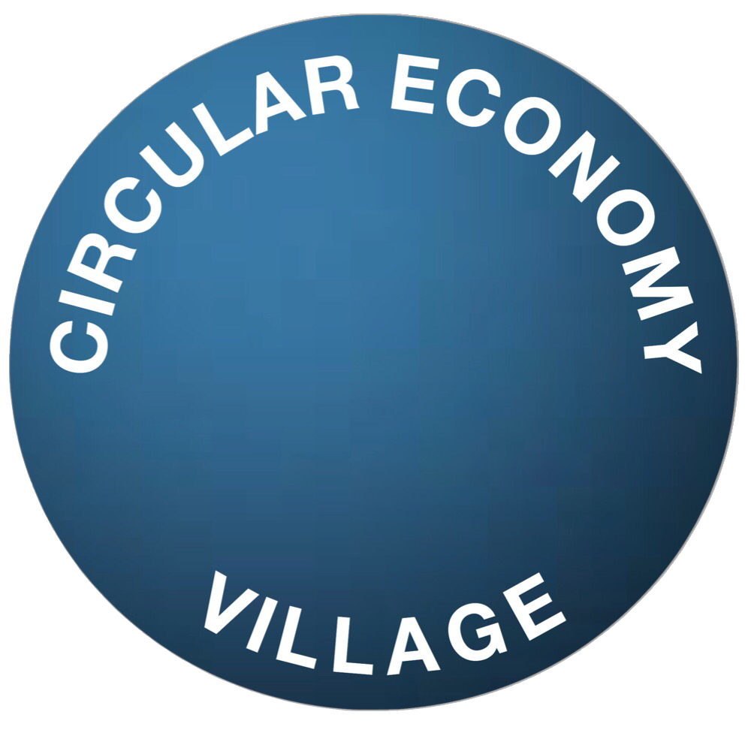
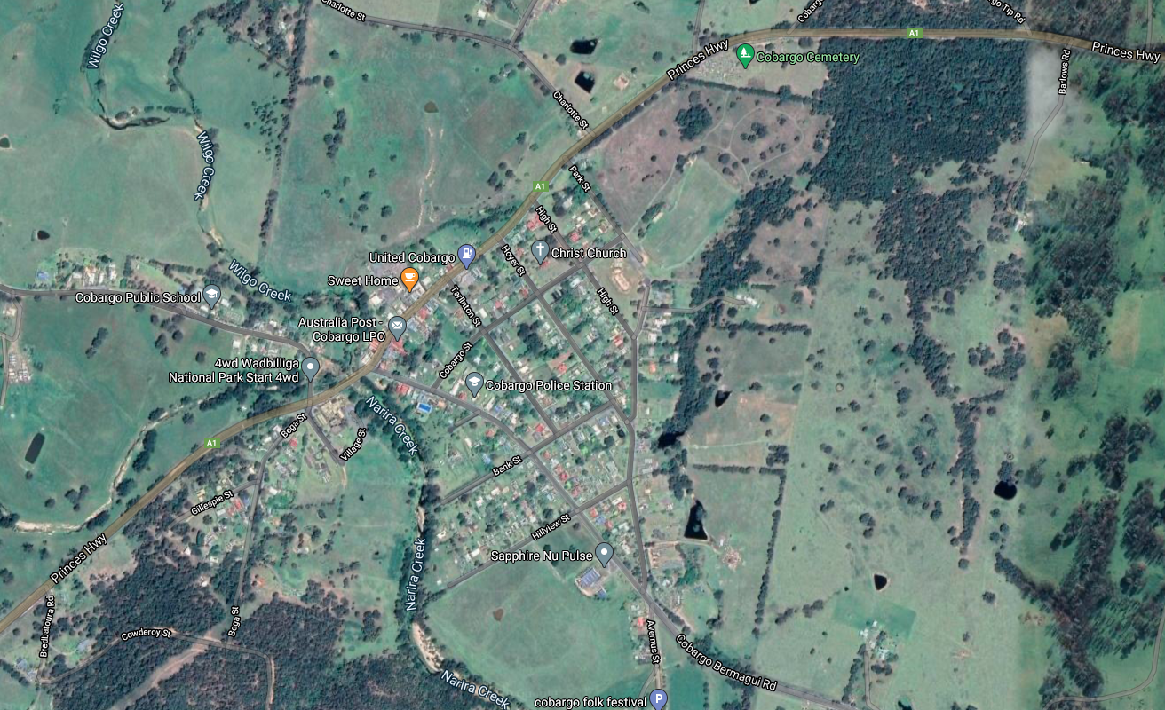
Strategic Planning – identify localities

Slide 10
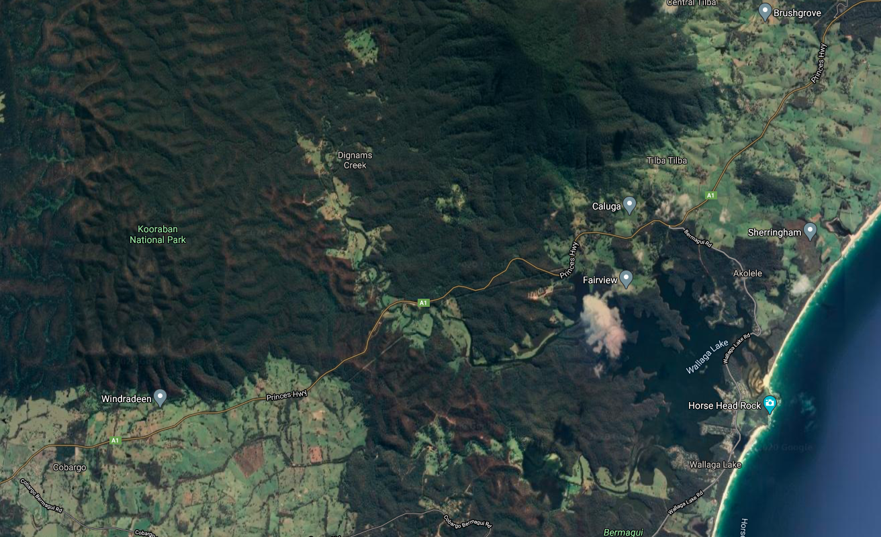
Locality Planning

Slide 11
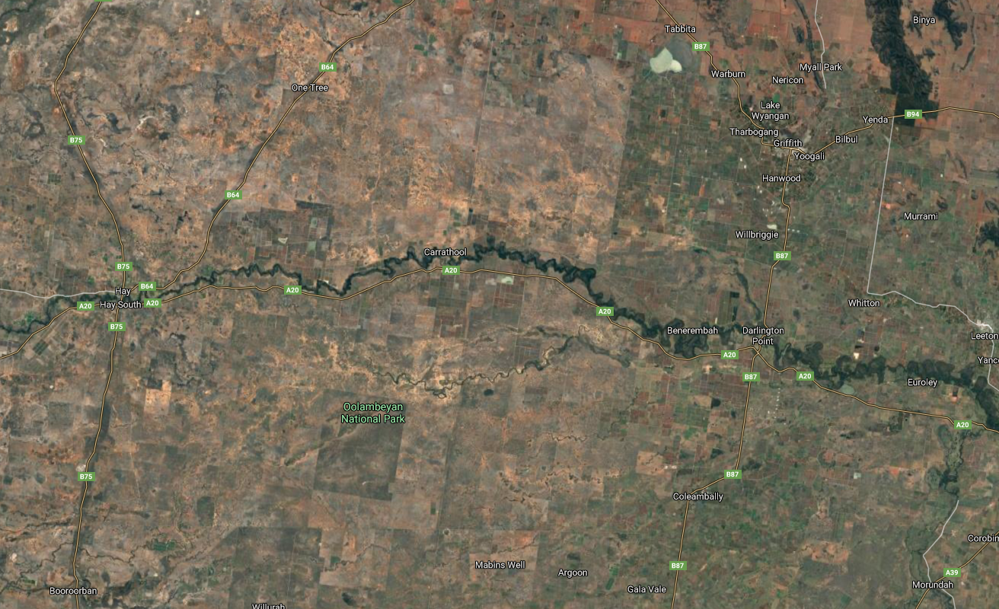
Locality Planning

Slide 12
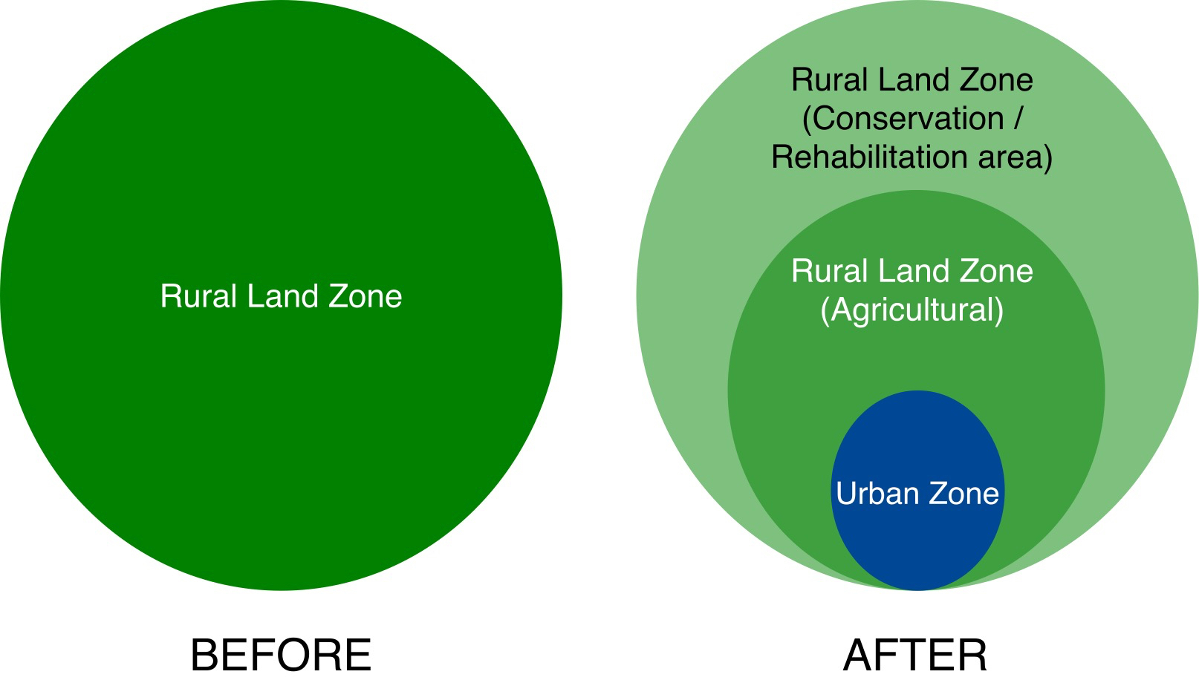
Masterplan &
Local infrastructure planning
Site area 40 hectares (100 acres)
Urban zone ~5 hectares to be rezoned

Slide 13
Tech innovations for community collaboration

Slide 14

Fractional real estate investment
domacom.com.au
Domacom sets up Managed Investment Trust to enable collective funding

Slide 15
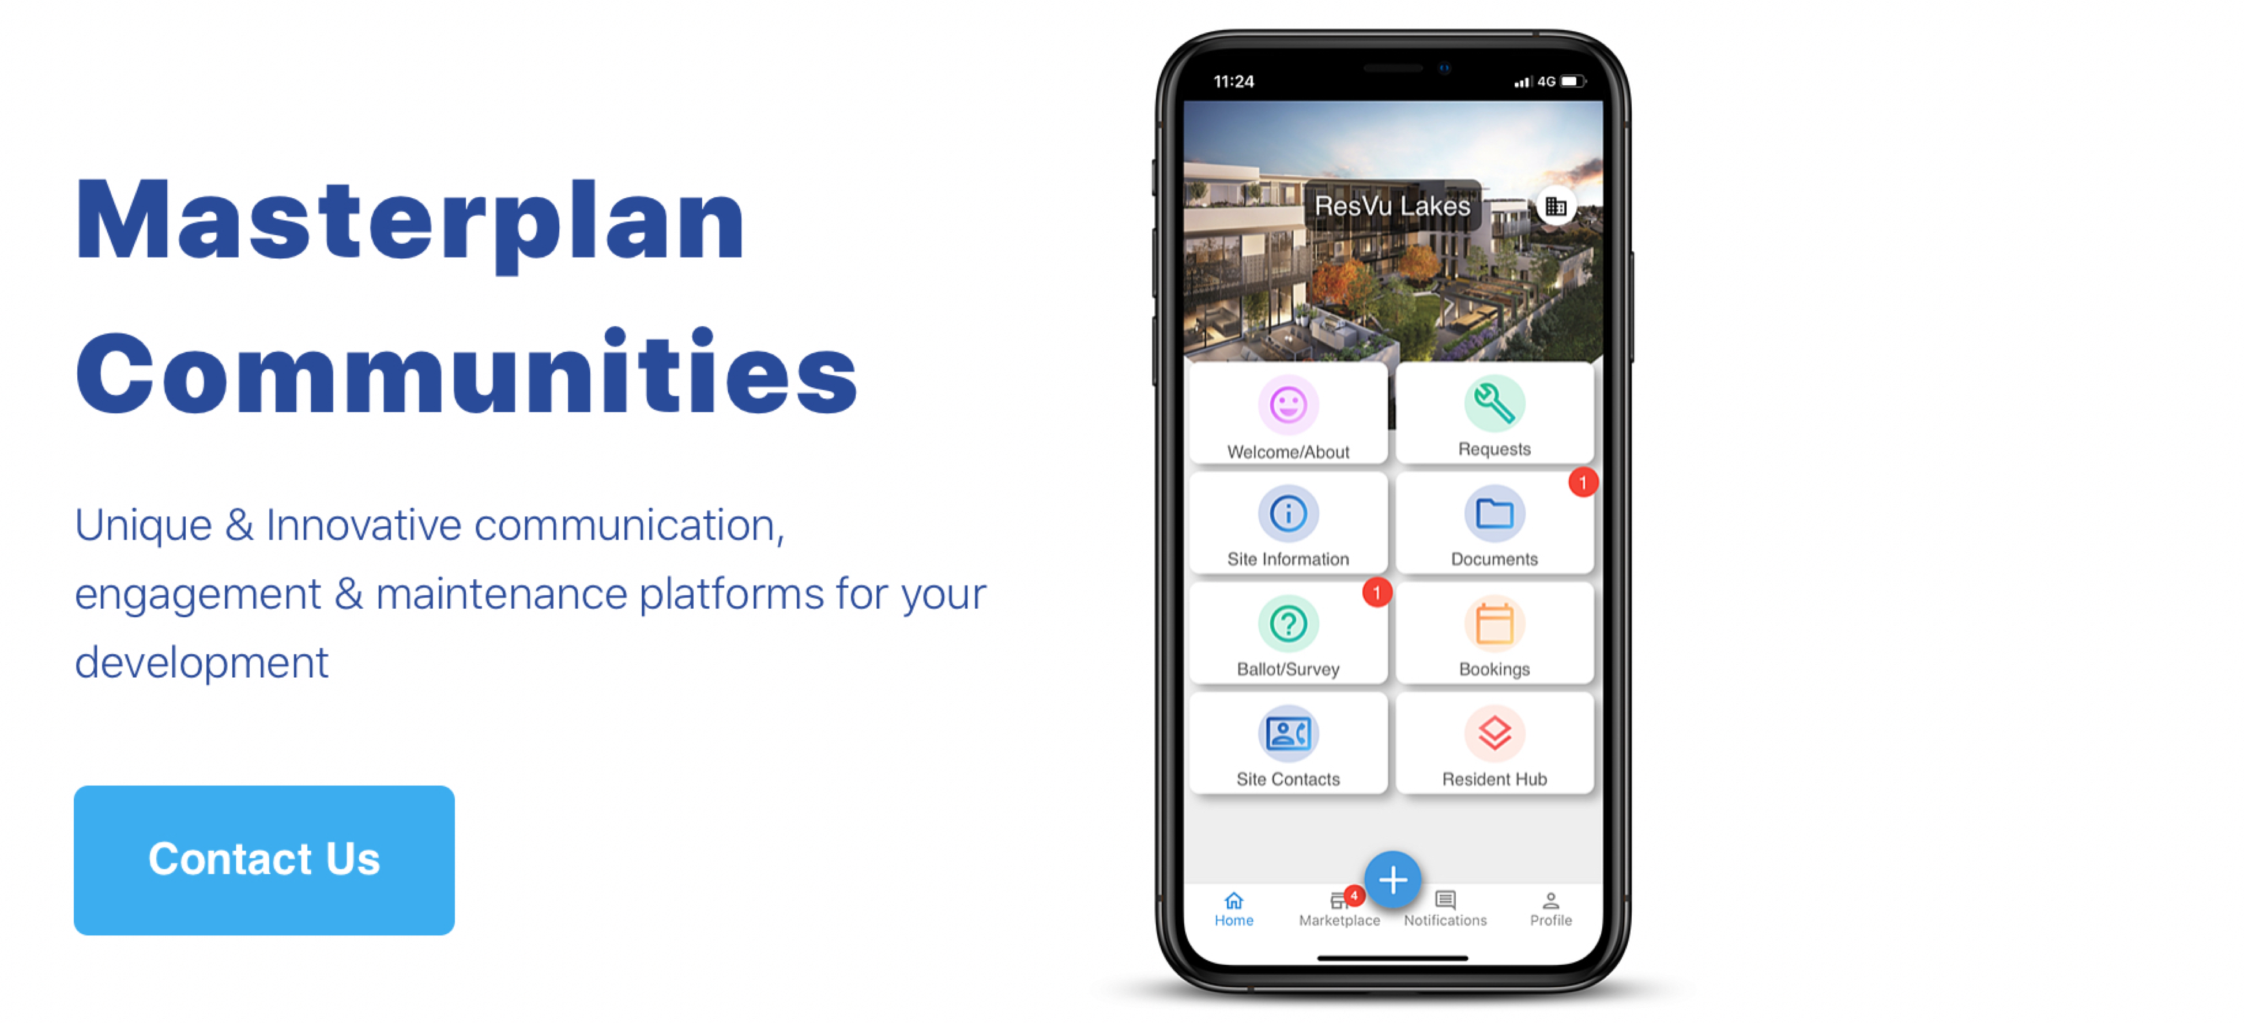
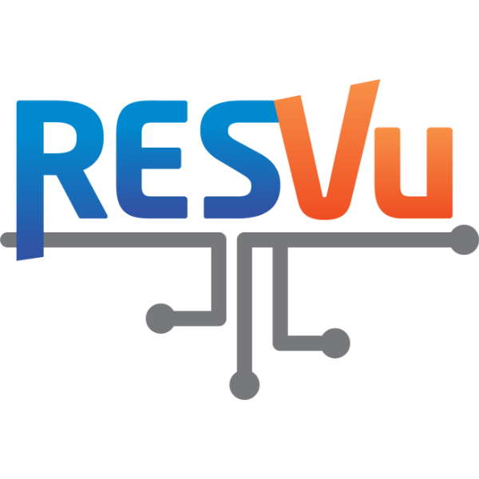
Community collaboration apps
resvu.com.au

Slide 16
Next Steps
Identify local government area for pilot projects
  Identify locations for several projects and site for pilot
  Work with Council to set up planning policy framework
Community communication platform (RESVU or equivalent)
Preliminary costing
Establish fractional RE investment structures (Domacom or equivalent)
Market analysis to find early adopters (investors and residents), strategy and campaign
Seed funding opportunities
Concept design (co-design)

Slide 18
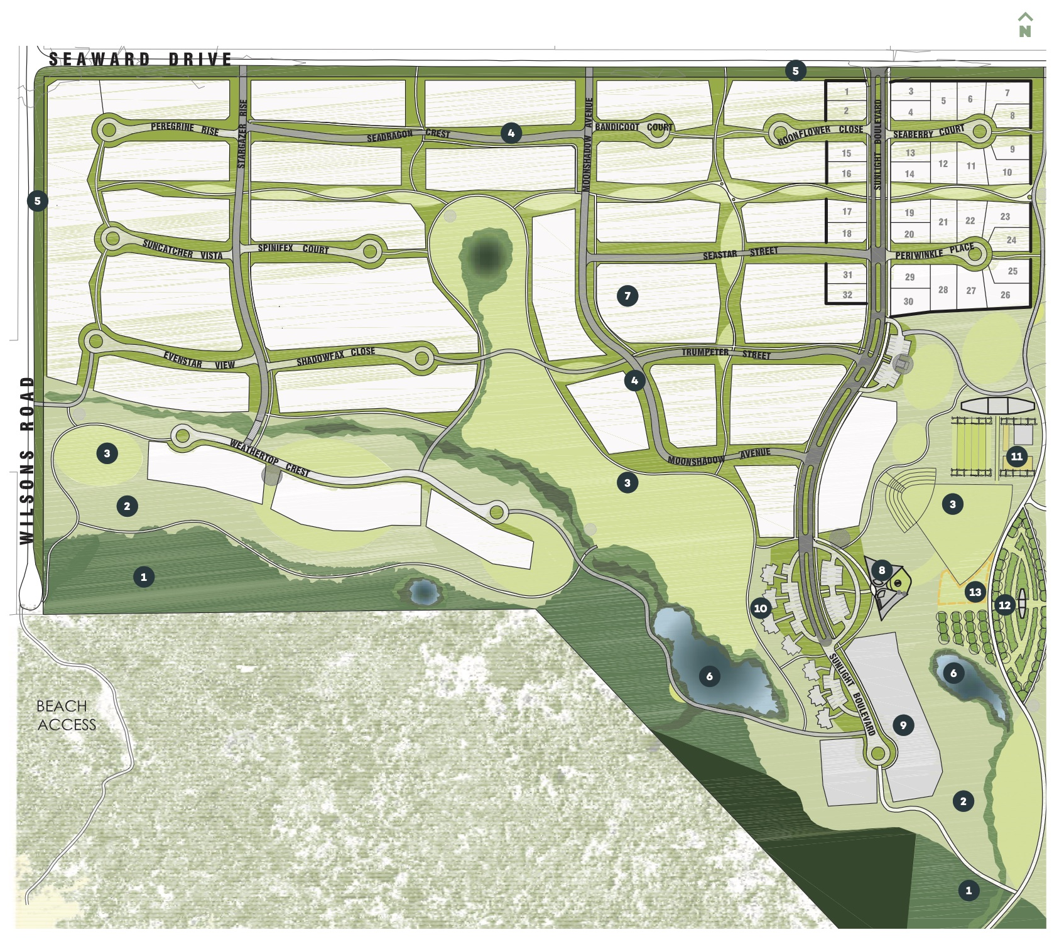
The Cape,
Cape Paterson, VIC.
88% reduction in electricity imported from grid (compared to 6star rated homes, source: RMIT)
work hub
Substantial community gardens & food production
Open space
Bush regeneration

Slide 19
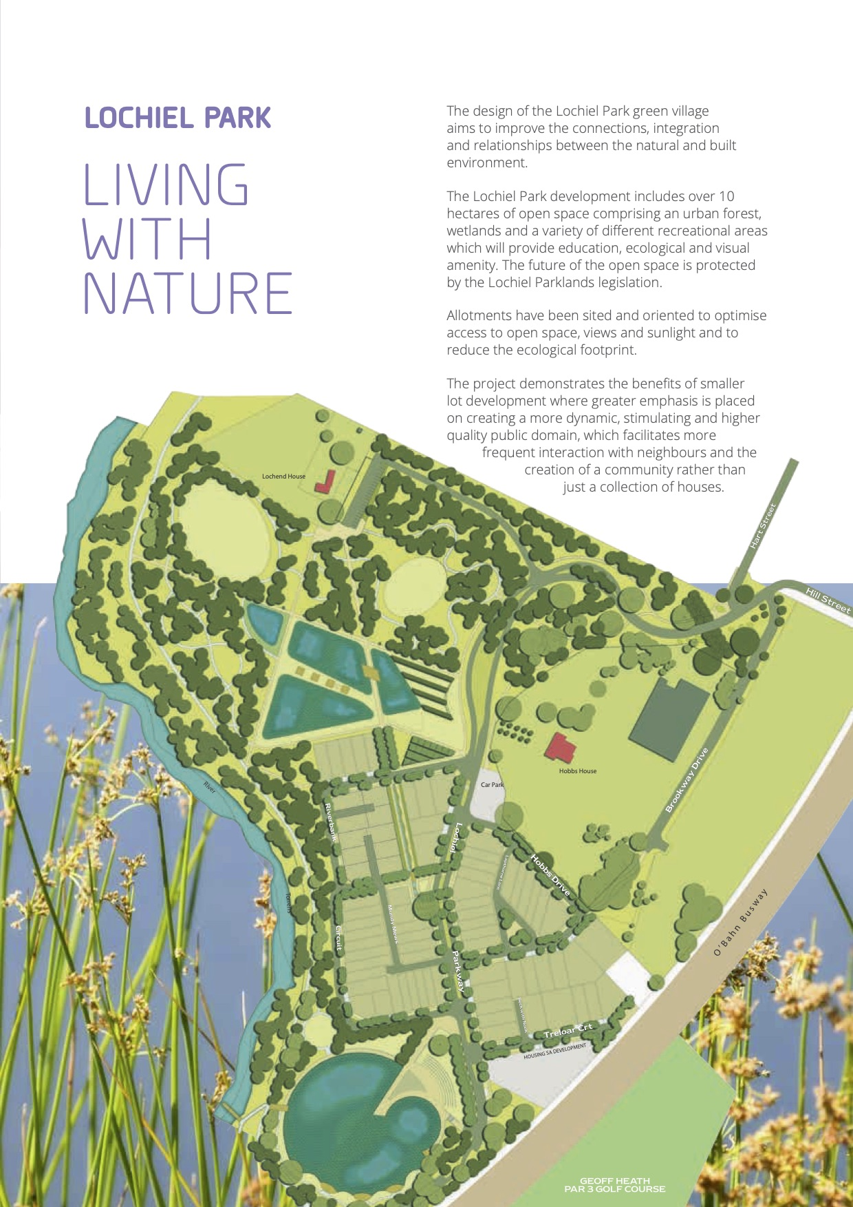
Lochiel Park
Renewal SA, Adelaide
64% reduction in energy
74% reduction in GHG emissions
74% saving of portable water

