Slide 1
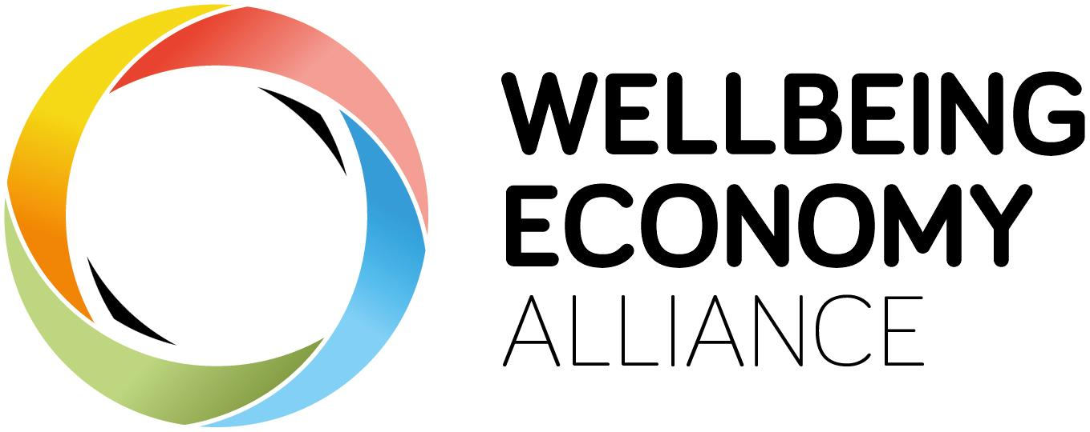
Designing Policies to Build a Wellbeing Economy
Amanda Janoo
October 11th, 2021
New Economy Network Australia Event
Notes:
Good morning, afternoon or even evening to you all. It is my great honour to be able to present the wellbeing economy policy design guide today. This guide was co-created by the WEAll membership with the aim of considering what practical steps we can take to build a wellbieng economy.
We won’t have time to go into every detail of this guide, but want I want to provide for you today is an overview of the key principles and processes that are explored in this guide as well as next steps and ways for you to get involved.
However, before we dive into the guide itself, let’s spend a moment exploring the wellbeing economy movement and why it’s so important.

Slide 2
What comes to mind when you hear the word
economy?
Notes:
Too often when we discuss the economy we speak of GDP growth rates, the stock market or income figures that present the economy as some abstract wealth generating machine beyond our control

Slide 3
The economy is the way we produce & provide for one another
Notes:
But the reality is we are the economy. The economy is just a word we use to describe the way we produce and provide for one another and the wealth generated in this system is just a means to improving our quality of life.

Slide 4
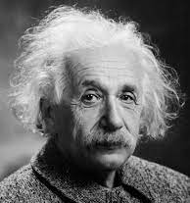
Perfection of means and confusion of ends seems to characterize our age.
Albert Einstein
Notes:
Albert Einstein once said that “perfection of means and confusion of ends seems to characterize our age” and there is perhaps no area where this confusion is clearer than when it comes to the economy.

Slide 5
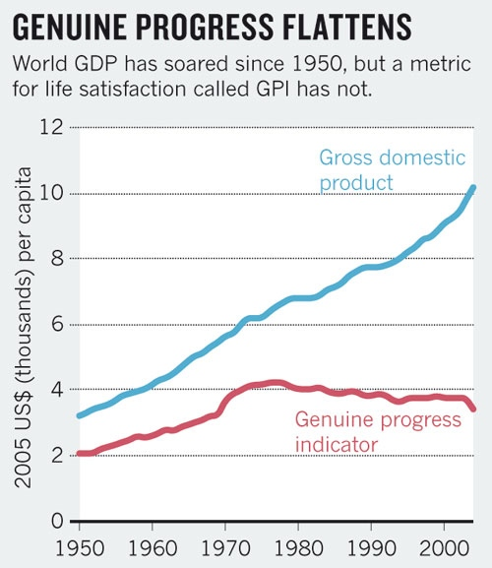
Costanza, R., Kubiszewski, I., Giovannini, E. et al. Development: Time to leave GDP behind. Nature 505, 283–285 (2014).
Notes:
Who hear has heard of GDP?
Can anyone tell me what GDP is?
GDP measures how much we produce and consume as a society and for decades this number has been used to assess n

Slide 6
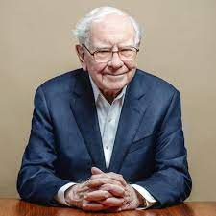
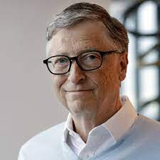
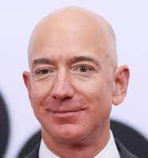
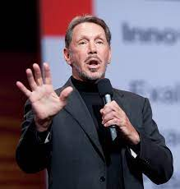
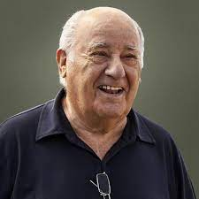
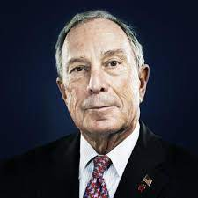
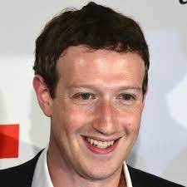
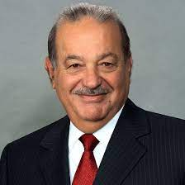
Just 8 billionaires own the same wealth as the poorest 3.6 billion
Notes:
Our current economic system is driving grotesque inequalities with 8 people now owning more wealth than half of humanity

Slide 7
Our planet, our home,
is being destroyed
Notes:
Our systems of production & consumption are destroying our planet, our home and threatening our very survival

Slide 8
Increasing anxiety, loneliness and despair Depression now ‘leading cause of disability’ worldwide (WHO) , distress & despair…
Notes:
And we’re seeing increasing loneliness, alienation & despair spreading throughout the world with depression now becoming the leading cause of disability worldwide and then you add a global pandemic on top of all of this and it becomes very clear that our current economic system is not cutting it

Slide 9
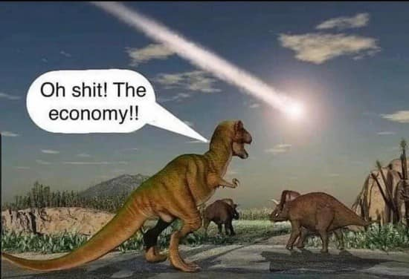
Notes:
As we strive to navigate these urgent crises it can be frustrating to see policy makers prioritize the economy above all else, as if forgetting that we are the economy and that it means nothing if it destroys our people and planet.

Slide 10
Standard Policy Story
Step 1:
Grow the economy
Step 3:
Fix the damages done to people & planet
Step 2:
Use Taxes to get some of that wealth
Notes:
However, the reason for this is because the for a very long time, the governments number one priority has been to promote economic growth above all else so they can take tax some of the wealth generated by this process to fix the damages done to people and planet in the process. But this approach is clearly not working…

Slide 11
People know
things need to change
Over ½ (globally) believe capitalism is doing more harm than good and democracy is being eroded
Growing sense of inequity & unfairness: institutions increasingly serve interests of the few
(Edelman 2020)
74% of people in G20 countries, want their country’s economic priorities to move beyond increasing profits & wealth to focus more on human wellbeing and ecological protection
(Global Commons Alliance 2021)
Notes:
As people have lost faith in our governments & their capacity to handle the crises of our time as the majority now see our economic system as doing more harm than good and our governments as facilitating this unjust & unsustainable system rather than promoting and protecting our collective wellbeing.

Slide 12
The Wellbeing Economy Movement
People and Planet are not here to serve the economy
The economy is here to serve us!

Slide 13
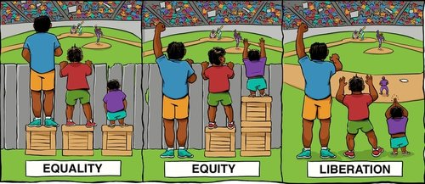
A WE moves us from fixing, healing and redistributing to getting it right in the first place.
Notes:
The question of our age therefore is how do we move from just fixing the negative outcomes of our economy to actually building an economic system that gets it right in the first place? How can we build economies that actively regenerate our natural work and ensure that all people are provided with the foundations that are necessary for a good life?

Slide 14
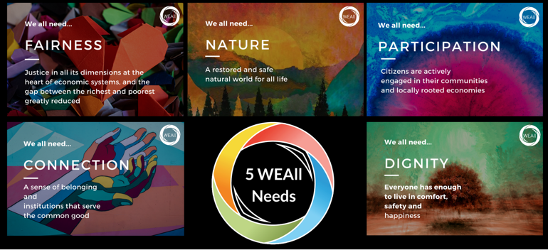
The Wellbeing Economy Vision
Notes:
This vision sits at the heart of the wellbeing economy movement. It is about developing an economy that does more of the heavy lifting and ensures that we are all provided with our fundamental need for participation, connection, nature, dignity and fairness.
Around the world the wellbeing economy movement comes under a lot of different banners, such as inclusive and sustainable development, regenerative economies, donought economics, circular economy and many more
But what all these movements have in common is a recognition that people and planet are not here to the serve the economy, it is here to serve us.

Slide 15
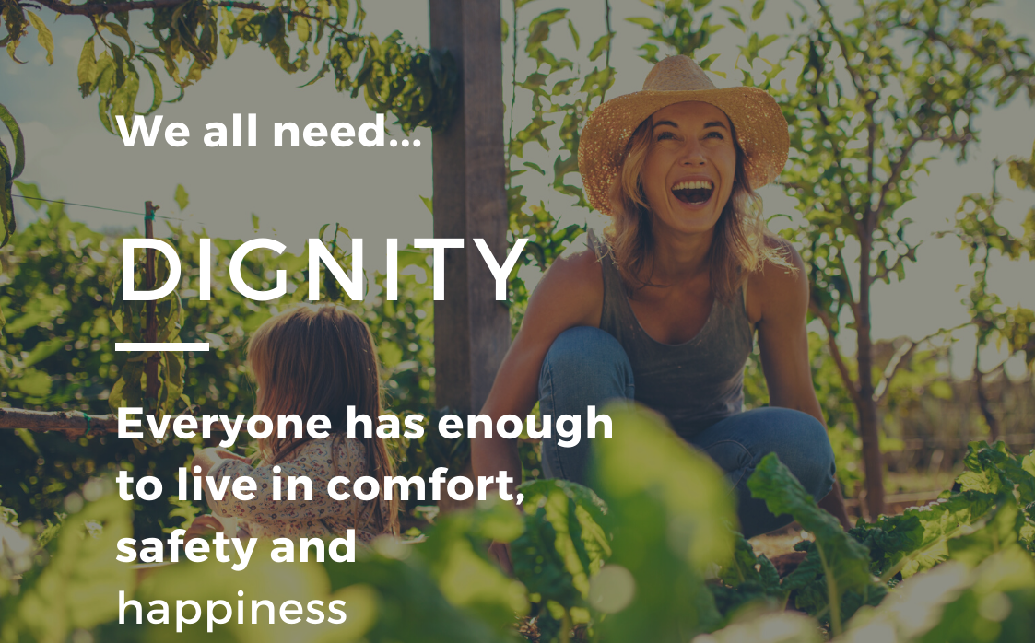

Slide 16
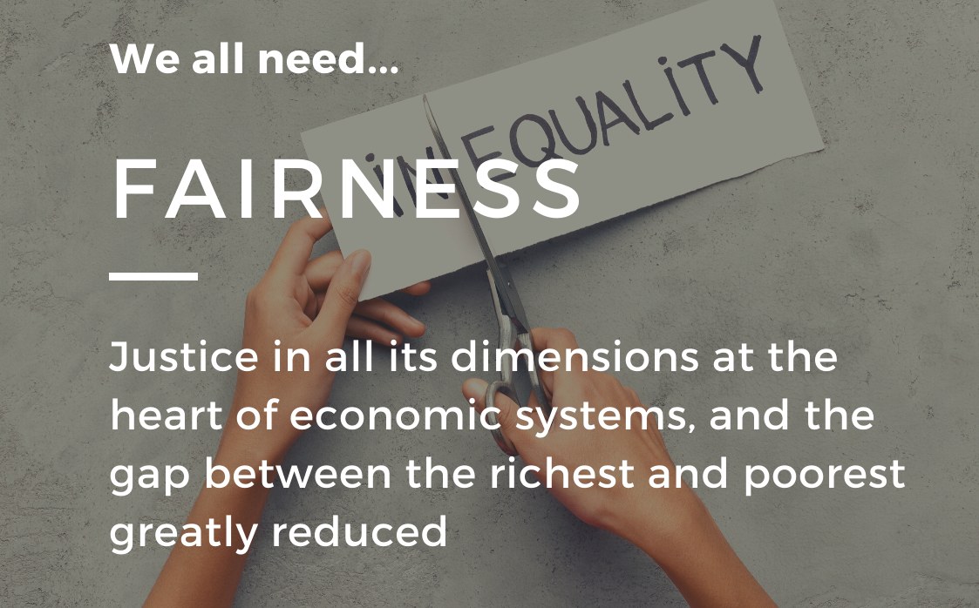

Slide 17
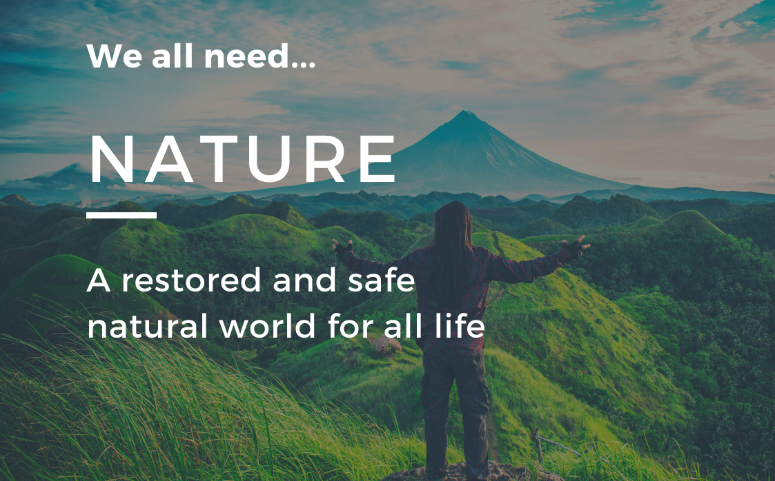

Slide 19
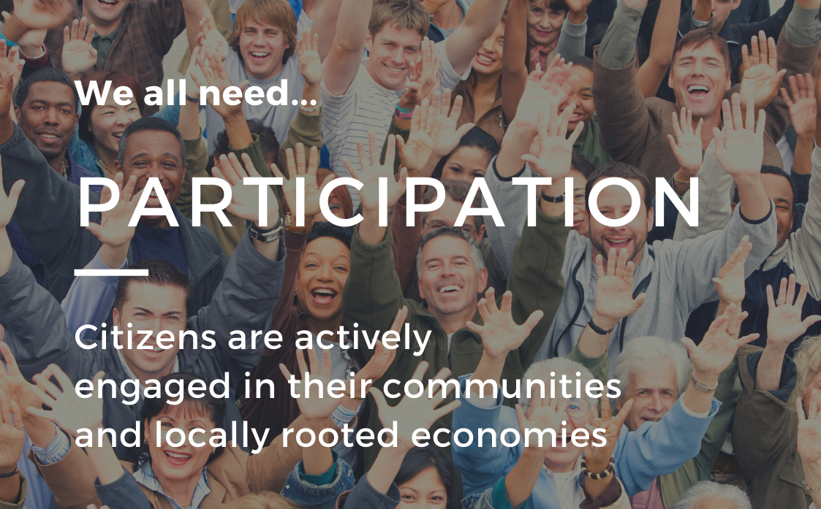

Slide 20
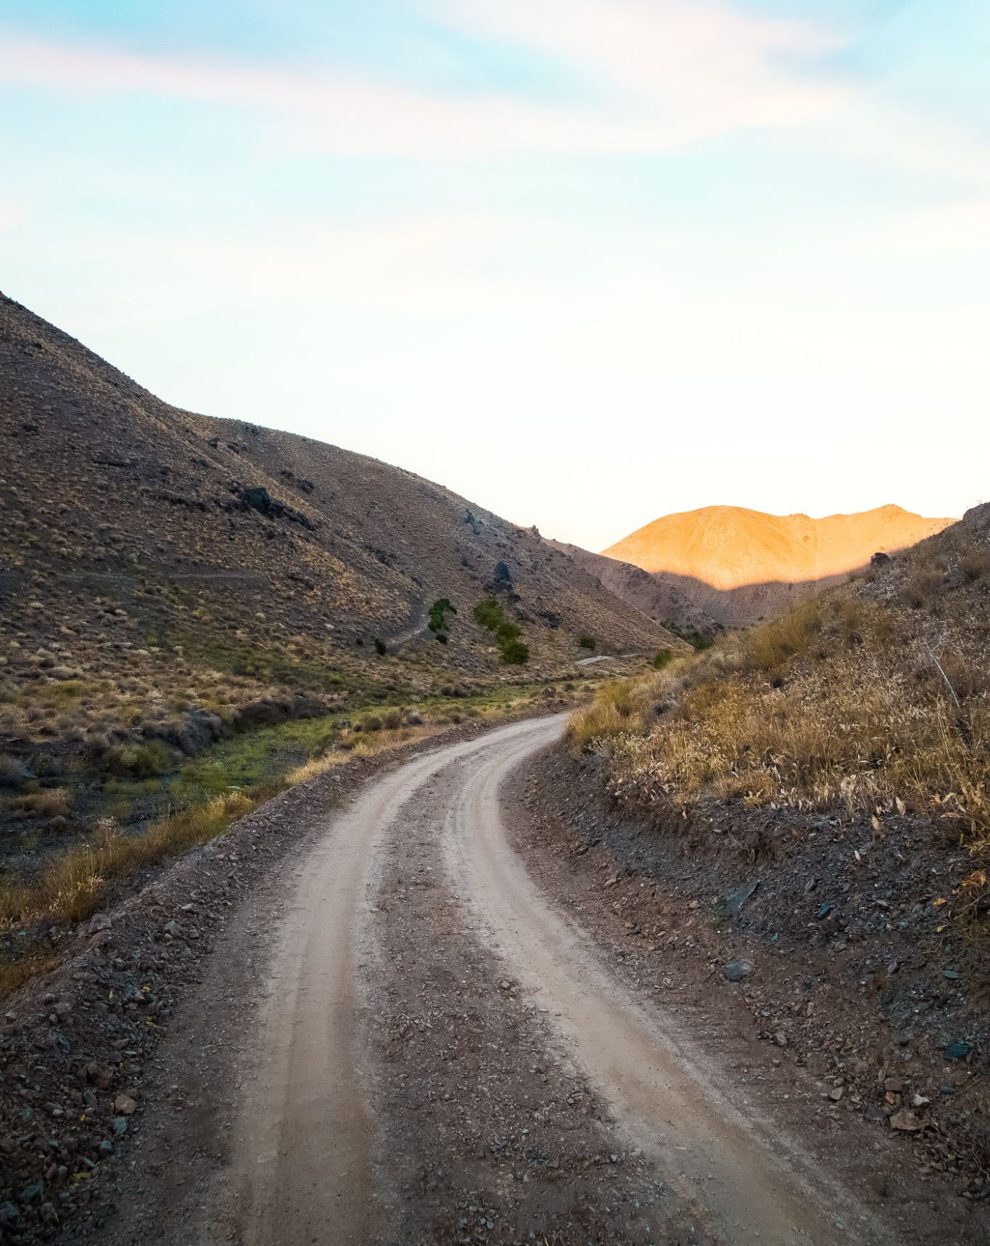
How do we get there?
Notes:
Sounds great right, so how do we actually get there?

Slide 21
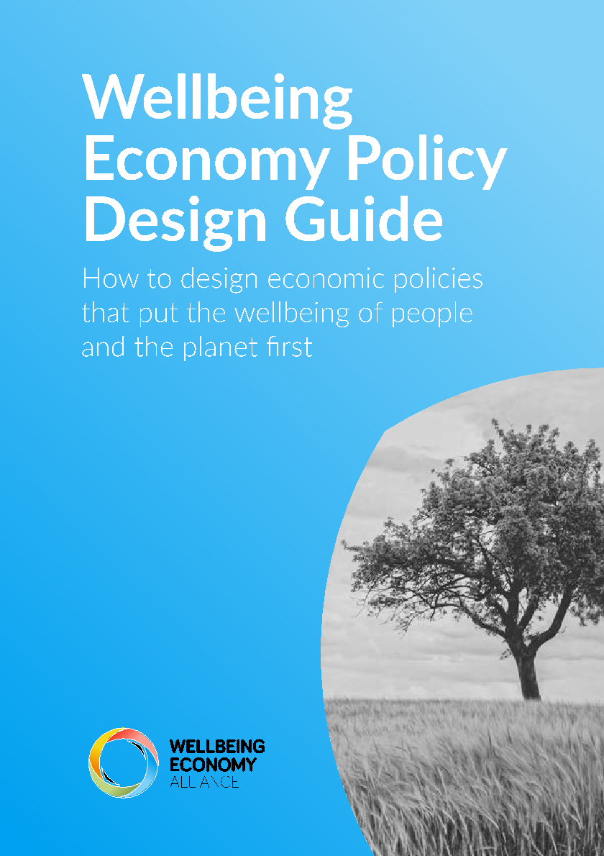
How can we design policies for a Wellbeing Economy?
“The flaws with mainstream economics and GDP are now well documented. What is needed is a practical a guide on how to build a Wellbeing Economy and how to organise this transition in a democratic and participatory way. Such a guide can help to institutionalise the process, give tools to policy makers and present the Wellbeing Economy as a feasible alternative!”
Till Kellerhoff, Club of Rome and WEAll Member.
Notes:
This question is what led WEAll to develop this policy design guide. Throughout this guide, you’ll find quotes like this one from our members who co-created this guide. I think this quote from Till really summarizes the motivation for this guide perfectly, as he said:
“The flaws with mainstream economics and GDP are now well documented. What is needed is a practical guide on how to build a Wellbeing Economy and how to organise this transition in a democratic and participatory way. Such a guide can help to institutionalise the process, give tools to policy makers and present the Wellbeing Economy as a feasible alternative!”
– Till Kellerhoff

Slide 22
What comes to mind when you hear the word
Policy?
Notes:
Too often when we discuss the economy we speak of GDP growth rates, the stock market or income figures that present the economy as some abstract wealth generating machine beyond our control

Slide 23
Policy is the way that we encourage or discourage particular behaviors to achieve our collective objectives
Notes:
But the reality is we are the economy. The economy is just a word we use to describe the way we produce and provide for one another and the wealth generated in this system is just a means to improving our quality of life.

Slide 24
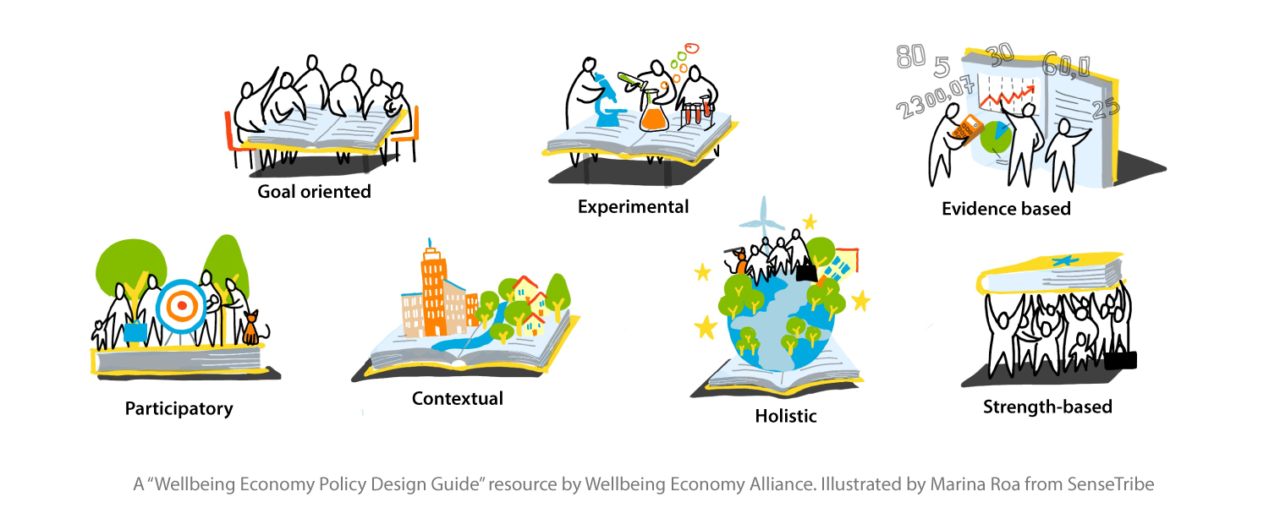
7 Principles of Wellbeing Economy Policy Design
Notes:
So with this vision in mind of illustrating thtat a wellbeing economy is not only desirable but also fully possible, we spent a lot of time discussing and considering the core principles for wellbeing economy policy design and although I won’t go into all of them right now, I will highlight a few that are particularly important for understanding the shape and form of this guide:
The first is the importance of a contextual approach. One of the most damaging aspects of our current economic system has been this one-size-fits-all appraoch that has facilitated cultural homogenization, disempowerment and inappropriate policies worldwide. Once we recognize that the way we produce and provide for one another is determined by our history, geography, policies, cultures and so much more, we realize that the shape and form of wellbeing economies will be different in different place as will their journeys and so this guide aims to be practical without being overly prescriptive as a way of providing space for a diversity of approaches.
At the heart of this guide sits the principles of participation, because the best way to find innovative strategies and ideas is to engage a wide range of people & perspectives. Not only with participation result in more inclusive and sustainable outcomes but we know that the act of participating itself is critical for our wellbeing as we all have a deep need to have a voice over the decisions that impact our lives. Therefore, throughout this guide, there is a strong emphasis on co-creative, deliberative & participatory approaches to policy design & implementation.
And finally, I’d like to draw our attention to the principle of taking a strength-based approach as this is a pretty radical shift, as standard economic and policy approaches are generally deficit or problems based. Whereby we begin with a consideration of the challenges or the things we lack rather than beginning with looking at what we have, taking a perspective of abundance and building on our existing strengths and capacities to achieve our goals rather than just mitigating negative outcome. A strength-based approach is transformative as it moves policy from simply correcting failures to proactively building the better world we envision.

Slide 25
What does this mean in practice?
Notes:
So what does this mean in practice, how would these principles change the way we design economy policies? The reality is that we’re speaking about emergent processes that will look different in different places but we decided to structure this guide according to 5 stages, Vision, Strategy, Policies, Implementation & Evaluation with relevant policy design processes in each. As you read this guide, it will be tempting to view this as a step by step guide but it’s not, the reality is that all of these various procesess are interconnected with one another and support one another and so we hope you will experiment with different combinations & add in new processes but all we ask if that you share your experience so that we can keep learning and building this together.
So without further ado, let’s dive into the guide itself.

Slide 26
Developing a Wellbeing Vision
How do we:
Understand what matters for wellbeing?
Craft & communicate our wellbeing vision?
Measure wellbeing?
Notes:
The first stage of this guide is about developing your wellbeing vision, expanding our notion of progress and becoming clearer on what kind of society and world we really want to live in so that we can proactively go about building it. It is about moving beyond measuring our success by our level of GDP growth to measuring our success by our level of wellbeing. Your wellbeing vision acts as your north star for the transformative journey ahead, and in working to develop this vision some questions emerge of how do we:
Understand what actually matters for wellbeing?
How do we craft and communicate our wellbeing vision?
And how do we measure wellbeing to keep us on course?

Slide 27
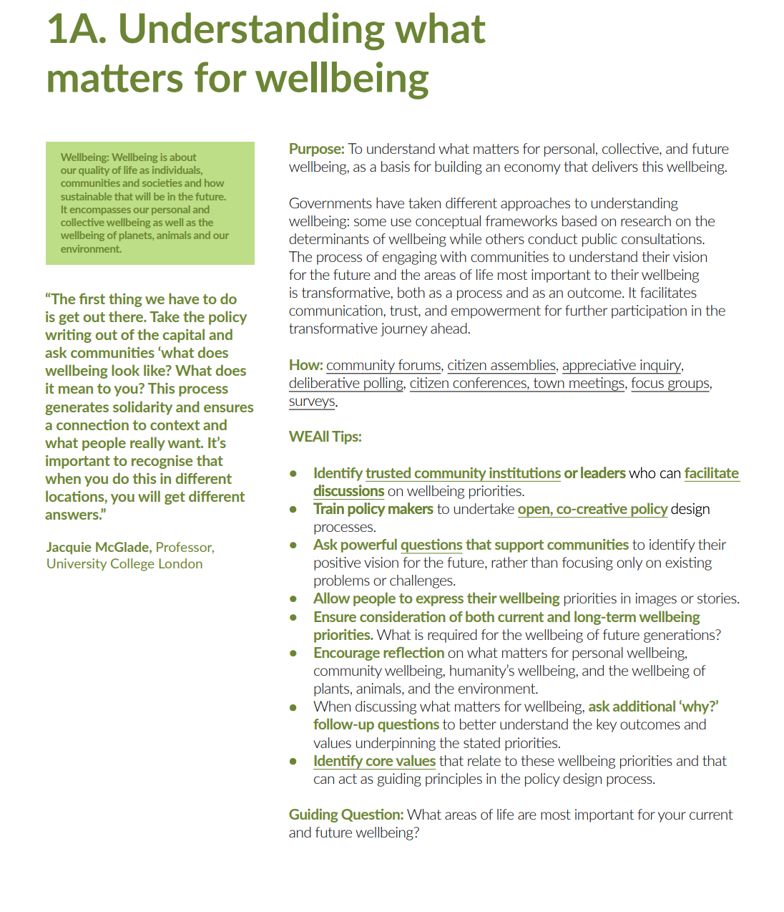
Notes:
Let’s start with the first, understanding what matters for wellbeing
This is an example of the structure of the guide, with each stage being broken into different relevant processes, within the “how” you’ll see that we recognize that there are lot of different ways to understand what matters for wellbeing and you’ll find hyperlinks throughout to guides and tools that can support you with these different options! You’ll also find Tips form the WEAll community regarding suggestions for undertaking this process and from our perspective the best way to understand what matters for wellbeing is to ask people.

Slide 28
Understanding What Matters for Wellbeing
Notes:
Germany for example, instigated a massive public consulation campaign with over 200 events around the country as well as online forums to really understand what mattered for people’s wellbeing and while’s they ended up with over 400 topics, these were some of the one’s that were discussed most often. What’s interesting is that when you ask people what matter’s for wellbeing, you end up with a mix of values (like solidarity, equity and respect), outcomes (like unspoilt nature and work-life balance) as well as processes (like political participation & civic engagement).
There is a tendency for governments to focus on the outcomes because these are the most tangible but an exciting new area to develop is considering how core values & processes into our policy design processes as well.

Slide 29
Crafting & Communicating Your Wellbeing Vision
Notes:
In order to get widespread buy-in for this transformative project, is it vital to communicate and engage with as many people as possible and use a wide variety of communication methods. Some countries present their wellbeing vision in the form of an infograph, framework or short vision statement while others use music and art. This is picture of Buen Vivir from Ecuador, which represents their wellbeing vision based on the indigenous vision of a society in peace and harmony with each other and their natural environment.

Slide 30
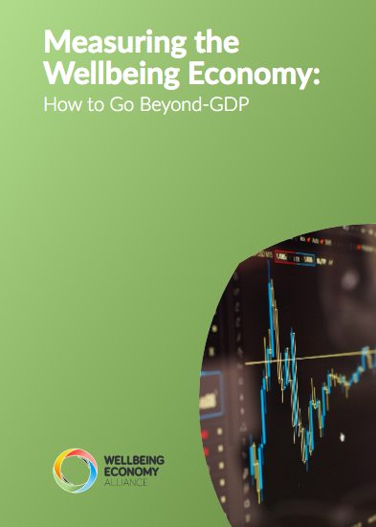
Measuring Wellbeing
Wales
Indicators for Communication
What the indicator measures should be capable of being summed up briefly in a way that will be immediately grasped by the public.
Ideally the indicator should allow comparisons with other places and so should be internationally recognised.
The significance of any changes should be immediately obvious.
All audiences need to believe that the indicator really does measure the outcome effectively and reliably, and the indicator should be understood in the same way by different groups.
Indicators must be selected and designed to avoid encouraging actions that improve the indicator at the expense of wider outcomes.
Notes:
This is the question where we see the most energy in the movement right now as there is, for very good reasons a deep desire to move beyond GDP. However, we should clarify that this guide does not say which indicators to use, but rather provides a variety of examples and explores how to develop wellbeing indicators.
In terms of process however, one of my favorite examples comes from Wales who determined what indicators to use based on criteria such as how effectively these can be communicated with a general audience and this is huge, as I worked for a long time training policy makers in economic analysis and the ability for people to intuitively understand the importance of the indicators that are being used is vital for success.

Slide 31
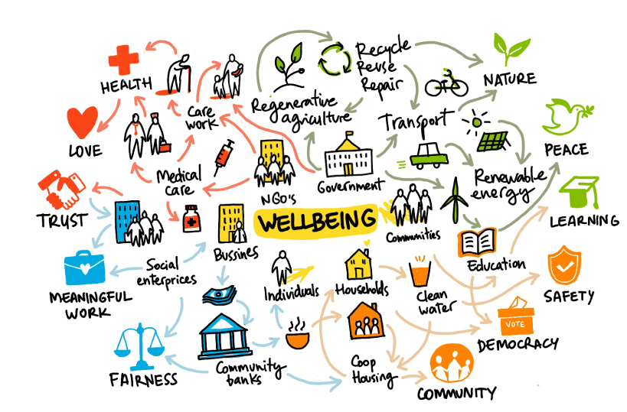
Designing a Wellbeing Economy Strategy
How do we:
Identify Wellbeing Economy activities & behaviors?
Align institutions & stakeholders
Manage trade-offs & power dynamics
Notes:
With this we move to the next stage of the guide which tries to move us beyond different measurements to a consideration of how to develop strategies for a wellbieng economy.
There are obviously a lot of relevant processes for this but we decided to start with 3:
Namely, how do we:
Identify wellbeing economy activities & behaviors?
Align institutions & stakeholders
Manage Trade-offs and power dynamics

Slide 32
Identifying Wellbeing Economic Activities & Behaviors
COVID-19 & Identification of Essential Workers
Notes:
So let’s start with Identify wellbeing economy activities & behaviors as this requires a pretty huge shift in thinking as for a very long time, we held a narrative that the purpose of the economy was to generate wealth and therefore we’ve promoted investors & big businesses that are most efficient at doing this but as we shift our vision of progress we will need to consider which economic activities & behaviors are most important for wellbeing
COVID-19 has been really interesting in this regard as it took policy makers very little time to identify the economic sectors or workers that are most critical for maintaining current wellbeing, with healthcare works, teachers, farmers, grocery clerks & government agencies & deliver drivers for example being classified as essential despite the fact that these are often the lowest paid workers in our societies. The challenge is to now expand this thinking and really consider what activities & behaviors are also vital for future wellbeing as well, so that we can develop strategies to meaningfully encourage and reward generosity, stewardship, environmental regeneration and more!

Slide 33
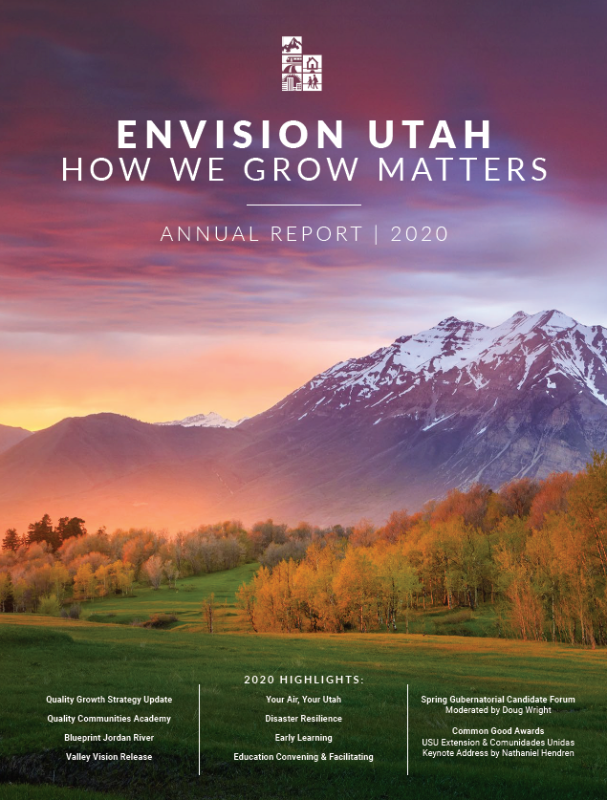
Aligning Institutions & Stakeholders
Case Study: Envision Utah
Long-term initiative
Visioning vs. Planning
Process vs. Project
Notes:
Another area where we are seeing exciting innovations regards institutional alignment and moving beyond a siloed approach to a more holistic & integrated strategy by government agencies & society at large so that all stakeholders are working collaboratively to build a wellbeing economy.
One of my favorite case studies in this guide is the Envision Utah Initiative, it began in the 1990’s because the state’s economy was growing incredibly fast and they were concerned about the impact this would have on nature & people’s quality of life if it was not strategically managed so they wanted to develop a participatory economic strategy design process.
At first they faced a lot of resistance as different towns and agencies felt they were in change of managing their economies & many powerful stakeholders a paternalistic view of what people needed from the economy and were wary of getting citizens involved in economic planning but they eventually got wide-spread buy-in by:
Presenting this as a long term initiative that was not confied to any policial or adminitative cycle
They framed it as a “visioning” rather than a “planning” exercise so it was not constrained by a narrow, technically managed process
And finally, they presented it as a continous process rather than a project so that it was not a short-term, managerially driven initiative
And indeed, it did take a long time, it took many years of public awareness raising, data gathering, public dialogue and participatory workshops to develop this strategy but in the end, Envision Utah is still going strong some 20 years later and is an example in the transformative power of engaging a broad range of stakeholders throughout this process
And with that, let’s get into the really tricky stuff:

Slide 34
Managing Trade-Offs & Power Dynamics
Notes:
The reality is that the only way to build a wellbeing economy is to proactively confront power imbalances in the existing system and to strategically manage trade-offs between different wellbeing priorities. A great example of this has been the just transition movement where we’ve seen some really inspiring, co-creative approaches to sunsetting environmentally harmful industries in a way that is just and fair to workers and communities who depend on these sectors.
What is vital is to engage people in these discussions so that they understand the tensions and trade-offs so that these often-painful decisions are made in a transparent and inclusive way.

Slide 35
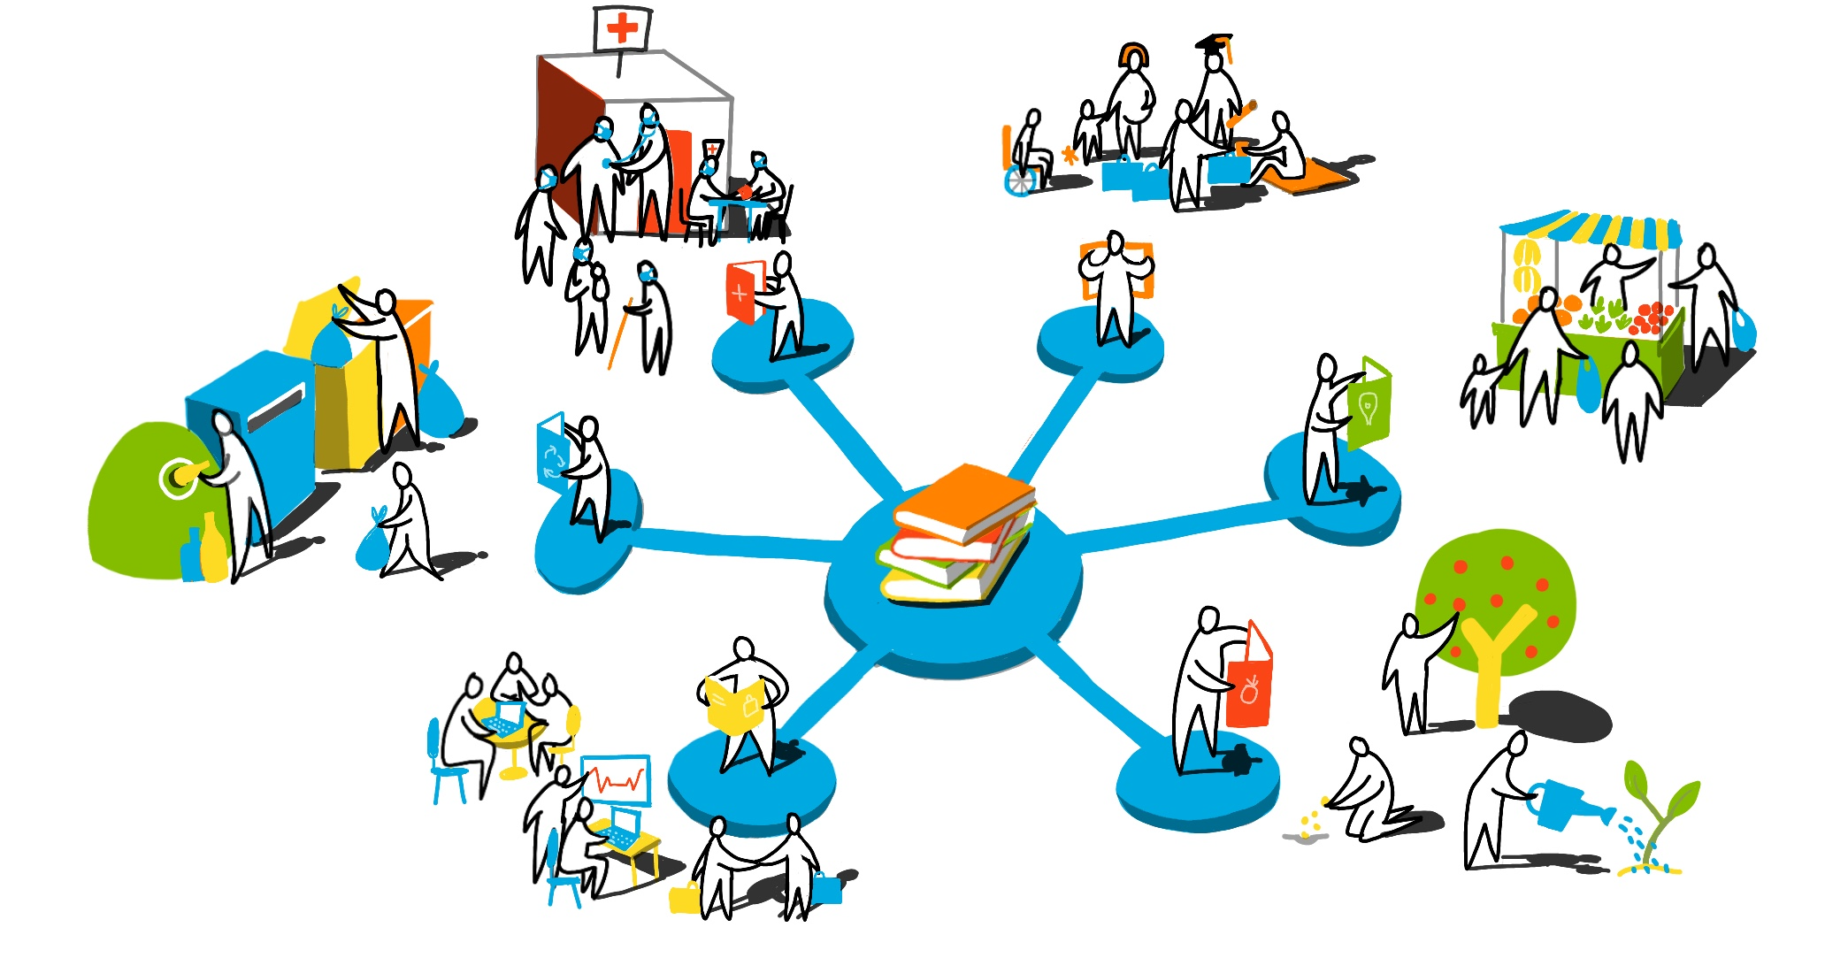
Assessing & Selecting Wellbeing Economy Policies
How do we:
Assess & reform existing policies?
Co-create new wellbeing economy policies?
Notes:
With this we move to the 3rd section of this guide which is on assessing & selecting wellbeing policies.
When you’re trying to achieve something as transformative as building a wellbeing economy, individual progressive policies are great but a coherent and integrated policy package is better. Policies are the way that we encourage or discourage particular types of behaviors and it’s important to first look at the existing policies in place and how aligned they are with your strategy & vision. In working in economic policy for nearly a decade, I can say this is something that rarely happens as we tend to focus on developing new policies rather than assessing and reforming the existing ones and so there is a lot of opportunities for innovation here.

Slide 36
Assessing Policy Packages
regulations
Incentives
Information Campaigns
Public Provision
The commons
Disincentives

Slide 37
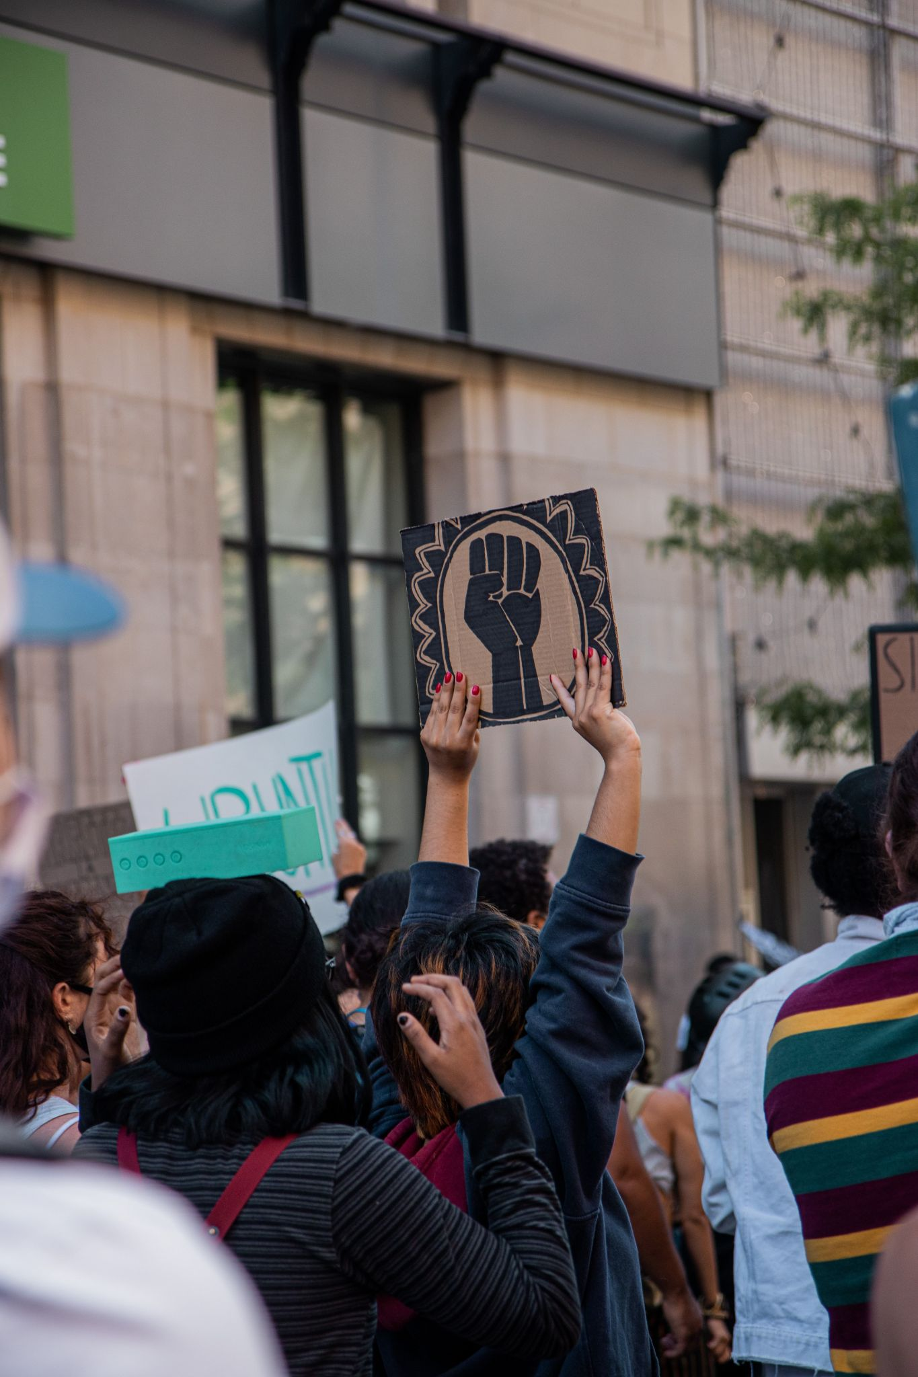
Moving Beyond Cost-Benefit Analysis
Notes:
In particular, there is a huge need to develop new ways of evaluating policies beyond their monetary cost or benefit to really considering how they impact our current and future wellbeing. An exciting example where we are seeing progress in this area is in gender budgeting & now some racial budgeting initiatives where governemnts are evaluating policies according to their effects on equity with the aim of supporting and empowering historically disadvantaged groups. Iceland for example, if already looking to learn from their gender budgeting experience to develop wellbeing policy assessment tools and I think in the coming years we’ll see a lot of exciting progress in this area as we begin to evaluate policies by our values rather than by their revenue generating potential.

Slide 38
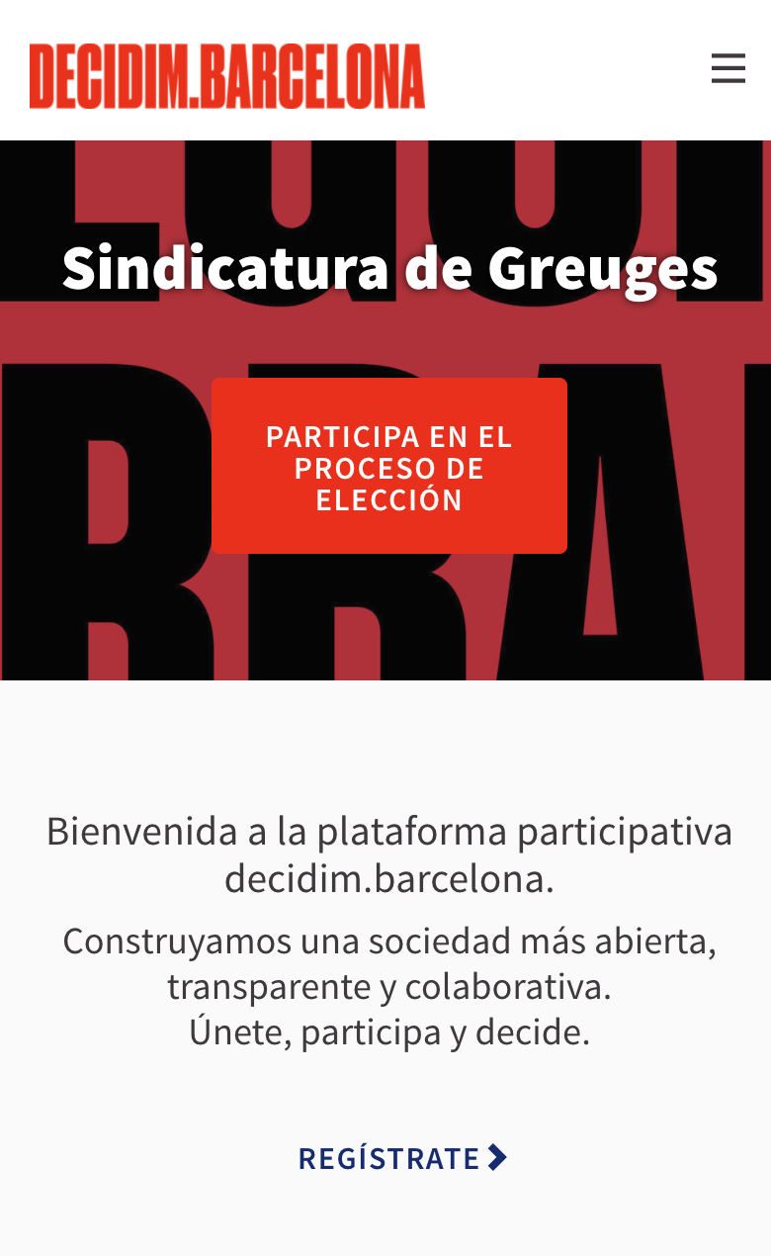
Co-Creating New Wellbeing Economy Policies
Notes:
If you haven’t picked up on it yet, this guide is all about co-creation of the wellbeing economy and we’re not alone, around the world we are seeing more and more participatory policy initiatives popping up all over the world. People want to be involved in developing policies and there are now incredible public facilitation & technological tools to support with this with examples such as the dedicim Barcelona intiative representing how techcnologies can be used to help revitalize democracy and transform economic policy making.

Slide 39
Implementing Wellbeing Economy Policies
How do we:
Empower localized policy implementation?
Participatory monitoring & adaptation of policies?
Notes:
I won’t go into as much detail with the final two stages as I want to allow time for the incredible policy makers who are on the front lines of the wellbieng economy movement to share their incredible wisdom and experiences but I do want to touch on some key points and ideas in the areas of policy implementation & evaluation.
The biggest issue with standard economic policy design is when it comes to implementation. Working in international development, there were no shortage of economic experts and Mckinsey consultants who would come in and develop these beautiful, strategic policies but at best these 2 million dollar docs would sit on a shelf somewhere never to be seen again and at worst people would actually try to implement a strategy they different understand and was generally not in their interest.
People need to be active agents not only in designing the policies but also adapting and implementing them according to their unique context. I realize this is no small feet but we can find inspiring example of governments relinquishing control and empowering local communities to implement, monitor & align policies to their context.

Slide 40
Empowering Localized Policy Implementation
La Paz - ‘Barrios de Verdad’
Notes:
I love the example of the Barrios Verdad in La Paz as after decades of failed poverty alleviation initiatives they decided to just give poor neighborhoods in La Paz the power to design their own infrastructure and community development plans and would give them the money they needed to execute them plus a some extra for adaptations or complementary projects that would come up along the way. The wellbeing impact of this initiative have been enormous and speaking of impacts…
Let’s discuss evaluation before concluding with next steps and a call to action!

Slide 41
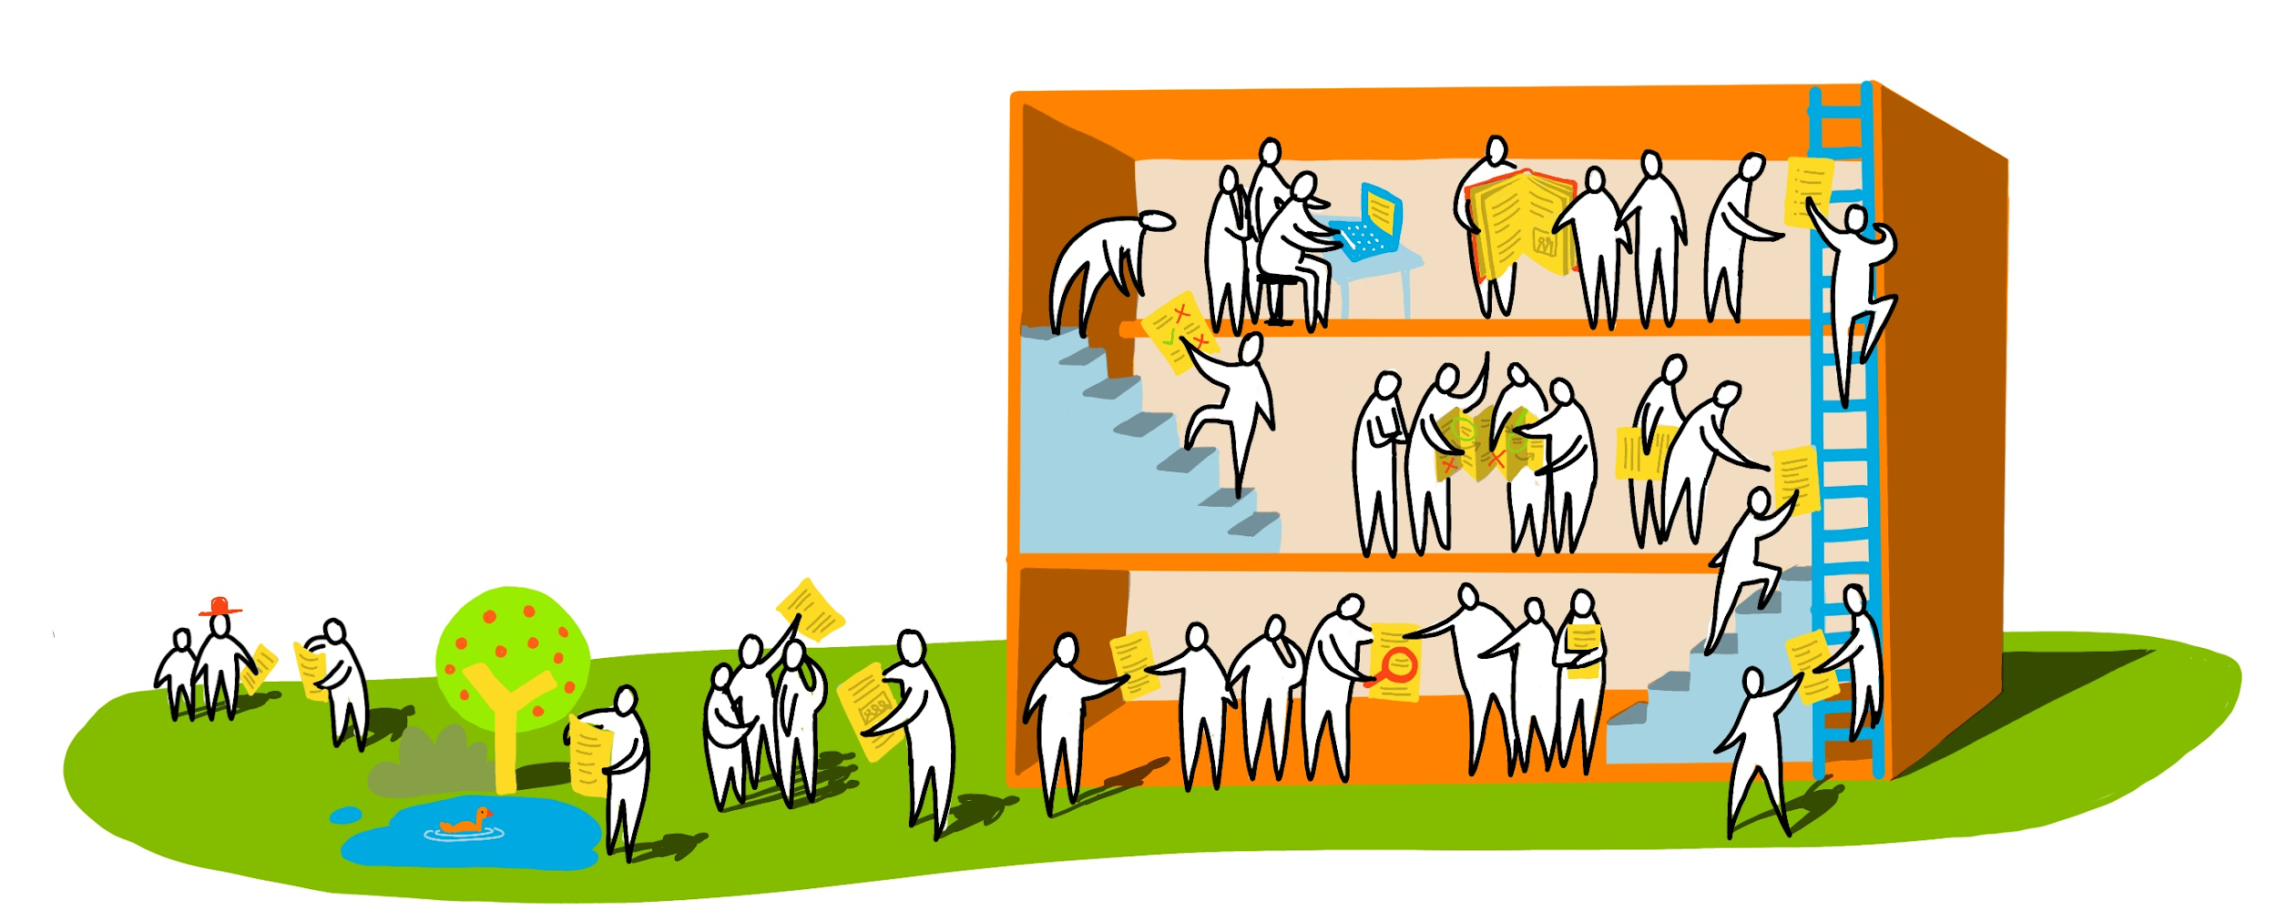
Evaluating Policy Impact on Wellbeing
How do we:
Assess wellbeing?
Identify best practice and areas for improvement?
Notes:
Evaluations and assessments play a critical role in all of the various stages we’ve explored, as they provide us with the information and evidence we need to make strategic and informed decisions and with the rise in wellbeing measurements, we’re seeing governments from the local to the global assessing wellbeing.

Slide 42
Wellbeing Assessments
Notes:
Scotland for example has been using their national performance framework and the SDG’s to really identify priority areas for intervention.

Slide 43
Identifying Best Practices and Lessons Learnt
Notes:
More than anything, what we need to embrace experimentation and learning, which can be really hard for policy makers who feel they can’t fail but we’re trailblazers here, trying to achieve something new and there is as much to learn from failure as there is success and so it’s about developing mechanisms to collective learning so that we all feel we are policy makers and a part of building the wellbeing economy.
With that, I hope I’ve convinced you to reach the guide. It’s not long and there are lots of pictures or atleast feel you’ve gotten a good flavor of what this guide is about.

Slide 44
The Wellbeing Economy Policy Design Guide
How can we develop and internalize new definitions of progress?
How can we continuously learn and adapt on our journey towards a wellbeing economy?
How do we expand our understanding of what the economy is and can be?
How we develop policies for systems change?
How do we foster participatory, context-appropriate, “bottom-up” policy making?
Notes:
So what does this mean in practice, how would these principles change the way we design economy policies? The reality is that we’re speaking about emergent processes that will look different in different places but we decided to structure this guide according to 5 stages, Vision, Strategy, Policies, Implementation & Evaluation with relevant policy design processes in each. As you read this guide, it will be tempting to view this as a step by step guide but it’s not, the reality is that all of these various procesess are interconnected with one another and support one another and so we hope you will experiment with different combinations & add in new processes but all we ask if that you share your experience so that we can keep learning and building this together.
So without further ado, let’s dive into the guide itself.

Slide 45
Putting the Guide into Action
Test-Piloting the Guide
Rolling out guide in Scotland, New Zealand, Canada, California… and more!
WEAll Policy Makers Network
Space for policy makers from around the world to share experiences, learn & support one another in building a wellbeing economy
Building Public Demand
Galvanize civil society & advocacy for wellbeing economy policy design by sharing core messages with general public.
Policy Guide 2.0
Keep building & developing guide by collecting more case studies, tools & experiences from you!
Notes:
More than anything, what we need to embrace experimentation and learning, which can be really hard for policy makers who feel they can’t fail but we’re trailblazers here, trying to achieve something new and there is as much to learn from failure as there is success and so it’s about developing mechanisms to collective learning so that we all feel we are policy makers and a part of building the wellbeing economy.
With that, I hope I’ve convinced you to reach the guide. It’s not long and there are lots of pictures or atleast feel you’ve gotten a good flavor of what this guide is about.

Slide 46
THANK YOU
Contact:
Amanda@weall.org
Newsletter
www.weall.org
Twitter
www.twitter.com/WEAll_Alliance
LinkedIn
www.linkedin.com/company/weall/
Instagram
www.instagram.com/weall_alliance/
Notes:
Thank you

